Slide 1
CLASS --- VIII
Chapter 2 ---- WORKING IN MICROSOFT EXCEL

Slide 2
INTRODUCTION TO MS-EXCEL
Excel is a computer program used to create electronic worksheets.
Within Excel user can organise data, create charts and perform calculations.
Excel is a convenient program because it allows user to create large spreadsheets, reference information and it also allows better storage of data.
Excel operates like other Microsoft (MS) programs and has many of the same functions and shortcuts of other MS programs.

Slide 3

AN OVERVIEW OF MS-EXCEL
MS-EXCEL consists of workbooks.
Within each workbook there are infinite number of worksheets.
Each worksheet contains rows and columns.

Slide 4
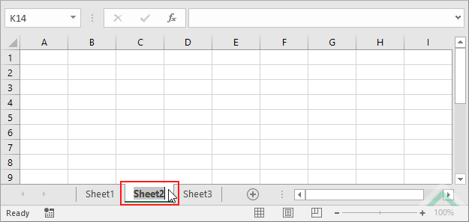
A WORKSHEET IN MICROSOFT EXCEL
A worksheet begins with row number 1 and column A.
The first cell has the address A1.

Slide 5
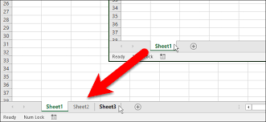
WORKING WITH SHEET TAB
You can insert a new worksheet by clicking on the Insert Worksheet tab present on the Sheet tab.
You can rename a worksheet by double clicking on it in the Sheet tab.
You can delete a worksheet by right clicking on the worksheet on the Sheet tab.

Slide 6
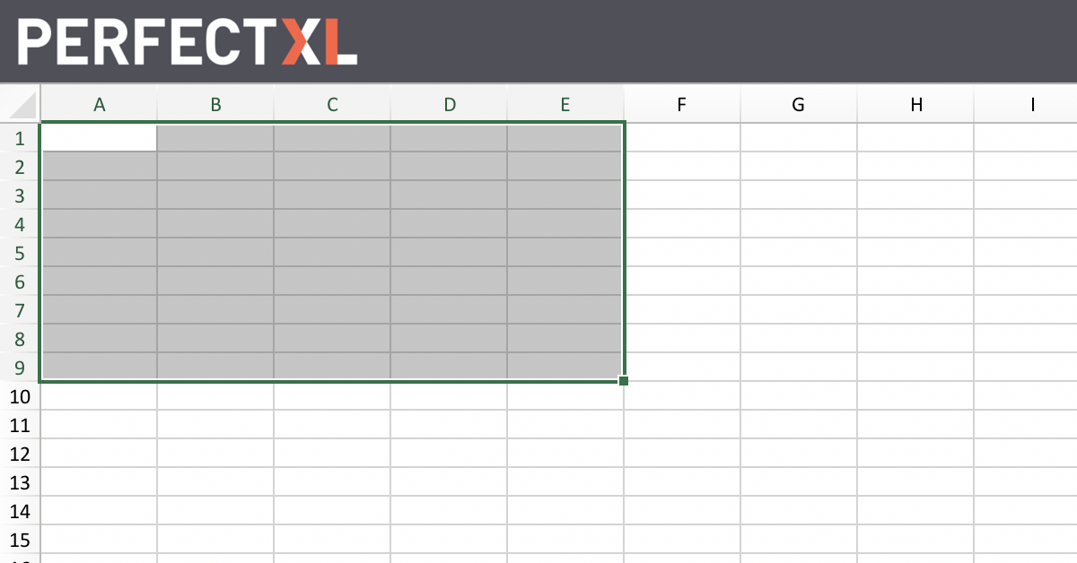
RANGE
A selected rectangular block of two or more cells is called a cell range or range.
It is represented by cell addresses of the first cell and its diagonally opposite cell.
For example, here in the given picture, the range is A1:E9

Slide 7
FORMULAS
A formula starts with an equals sign ( = ).
It can contain numbers, cell addresses, cell ranges and operations.
For example, to show the sum of the data in cells A1, B1 and C1 in the cell D1
Type =A1+ B1+ C1 in the cell D1 and press Enter.

Slide 8
CELL REFERENCING
Relative
For eg:
A1
Absolute
For eg:
$D$3
(Type a dollar sign before row and column heading)
Mixed
For eg:
$B2 or B$2
(Type a dollar sign either before row heading or before column heading)

Slide 9
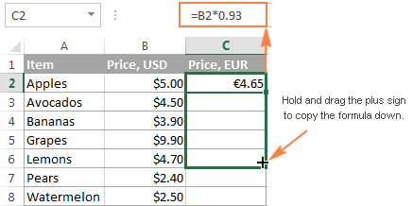
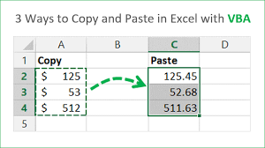
COPYING A FORMULA
a) USING THE FILL HANDLE
b) USING COPY AND PASTE

Slide 10
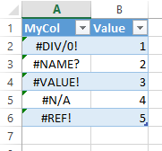
ERRORS IN EXCEL
An error indicates that there is something wrong with the way the formula was entered.

Slide 11
THANK YOU

