Slide 1
WEATHERING AND SOIL FORMATION
[ROCKS]

Slide 2
METAMORPHIC ROCKS
CHANGED FORM
TEMPERATURE
PRESSURE
TERTIARY ROCKS
TYPES
TEMPRTATURE
PRESSURE

Slide 3
CHARACTERISTICS OF METAMORPHIC ROCKS
COMPACT ,HARDER
NO FOSSILS
HIGLY COMPRESSED
CLOSE BANDED STRUCTURE

Slide 4
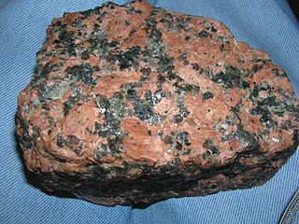
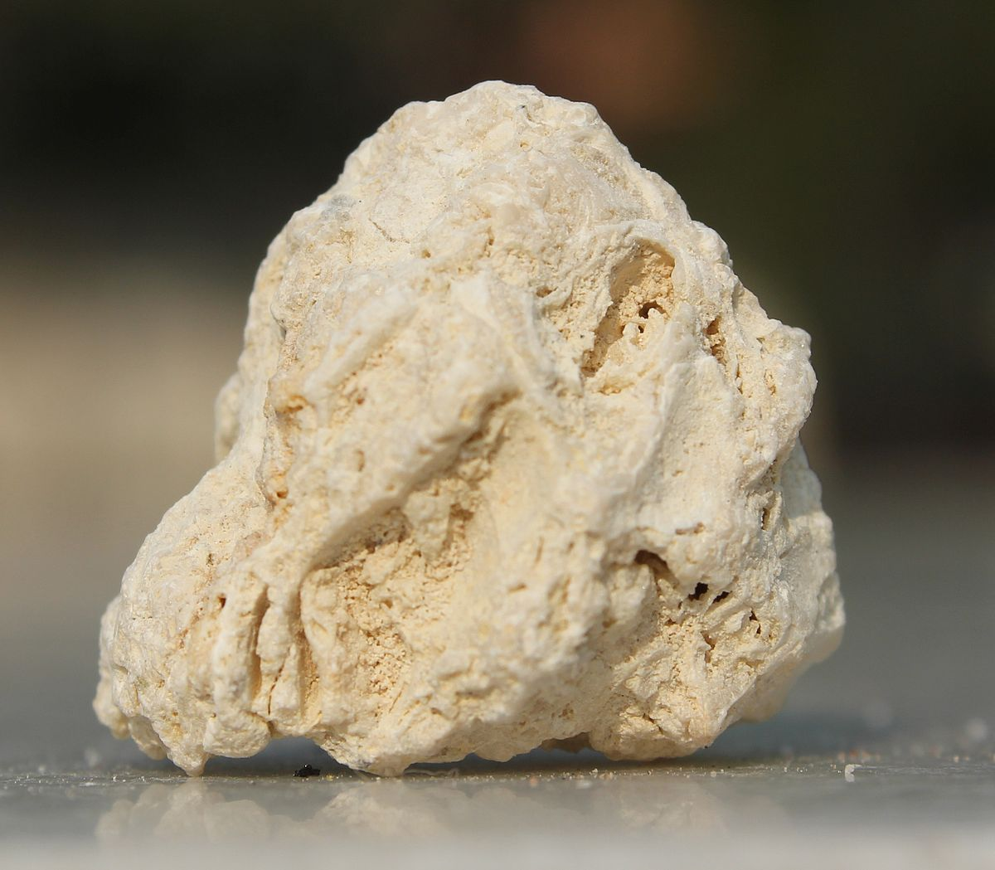
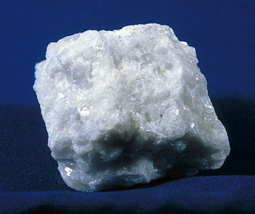
WEATHERING & EROSION
IGNEOUS ROCKS
MELTING
SEDIMENTARY ROCKS
ROCK CYCLE
TEMPERATURE & PRESSURE
TEMPERATURE & PRESSURE
MELTING
WEATHERING & EROSION
METAMORPHIC ROCKS

