Slide 1
ATOMIC STRUCTURE
CLASS –XI
SUBJECT – Chemistry

Slide 2
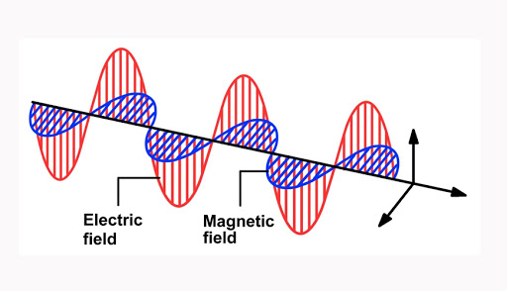
ATOMIC STRUCTURE
Wave Theory-
1.Wavelength(λ)
2.Frequency(ⱱ)
3.Velocity(C)
C= λⱱ
4.Wave Number
5.Amplitude (a)

Slide 3
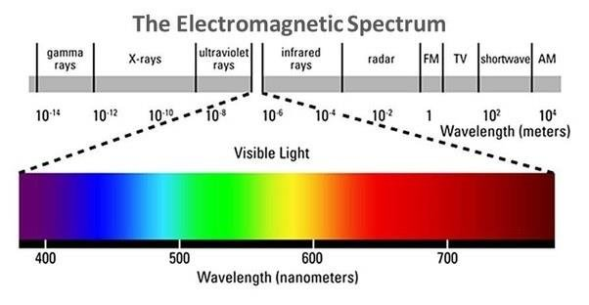
Electromagnetic Spectrum
Plank’s Quantum Theory of Radiation
E=hⱱ or E=ch/ λ According to Quantum theory a body can emit or absorb energy only in an integral multiple of quantum and can never be absorbed or emitted in fractions of quantum.

Slide 4
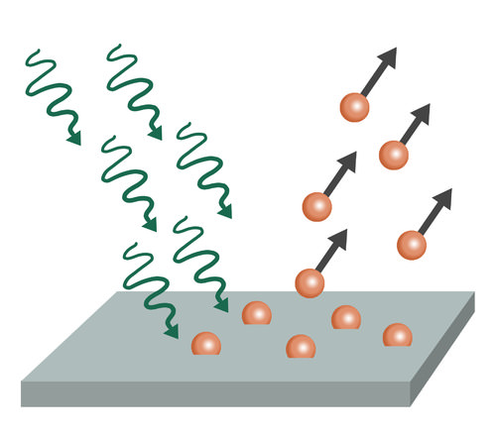
Photoelectric Effect
E = W + KE hv = W + KE
KE = hv – w
w = hv₀ Thus, Maximum kinetic energy equation becomes:KE = 1/2mv²max=hv–hv₀
1/2mv²max=h(v−v₀)
V_{max} is the maximum kinetic energy of the electron.
Dual Nature Of Light
Light behaves as a particle as well as wave.
Q.A photon of wavelength 400nm strickes a metal surface .The electrons are ejected with a velocity 5.85X10⁵ ms⁻¹.Calculate the minimum energy required to remove an electron from the metal surface.

Slide 5
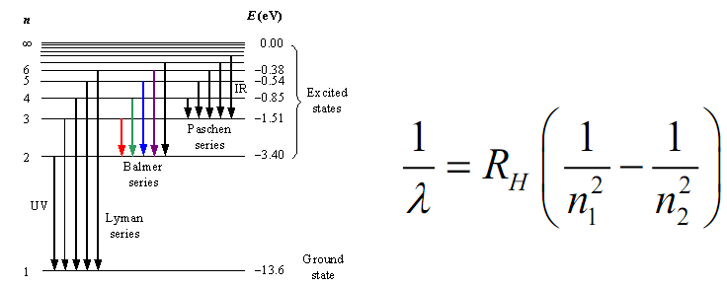
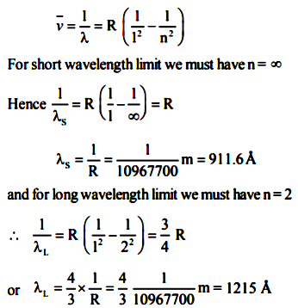
Atomic Spectra(Evidence for the quantised electronic energy level)

Slide 6
Energy And Radius Of A Particular Orbit

Slide 7
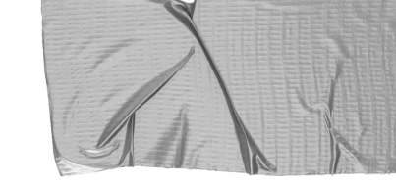
de Broglie equation
Λ = h/mv or h/p
Every object posses a mass and a velocity behave both as particle and as a wave.
An e⁻ is moving with a K.E of 4.4.55x10⁻²⁵ J calculate it’s de broglie's wavelength ?
Hint:
K.E = ½ *mv²
Answer:
7.278x10⁻⁷ m

Slide 8
Heiserberg’s Uncertainty Principle
Δx . Δp >= h/4Π
Δx . Δv >= h/4Πm
It is impossible to determine simultaneously the position and momentum of a moving microscopic particle with absolute accuracy.
Calculate the uncertainty in momentum of an e⁻ if uncertainty in it’s position is 1Å.(10⁻¹⁰ )
Hint:
Δx . Δp = h/4Π
Answer:
5.18x10⁻¹⁵ kgms⁻¹

Slide 9
Concept of orbit
mvr=nh/2Π , where n = 1,2,3....
Energy of an e⁻ is fixed in a particular orbit
ΔE = E₂-E₁ = hν
Bohr’s model For H & H Atoms
Merits & Defects
Merits
Stability
Energy
Radius
Defects
Zeeman’s Effect & Stark Effect
Fine Spectra
He,Li etc.
Heisenberg's uncertainty principle

Slide 10
THANK YOU

