Slide 1
RECONSTITUTION OF PARTNERSHIP
ADMISSION OF PARTNER
Admission of a new partner is the inclusion of a new partner as an associate or partner to an existing enterprise is known as an admission of a partner. For the right to share the profit of the partnership firm, the new partner is required to bring some amount which is known as a premium or his share of goodwill.
With accordance to the Partnership Act 1932, a new partner can be admitted into the enterprise only with the agreement of all the existing partners until and unless otherwise consented upon. Suppose A and B are partners sharing profits and losses in the ratio of 2:1 on 1st April 2019 they admitted C as new partner with 1/6th share in profits of firm then in that condition existing partners ratio will be changed

Slide 2
PURPOSES OF ADMISSION OF A NEW PARTNER
For taking additional capital for expansion of business
For acquiring additional managerial skill
To encourage a capable employees by taking him into partnership
ADJUSTMENTS AT THE TIME OF ADMISSION OF A PARTNER
Calculation of new profit sharing ratio
Calculation of sacrificing ratio
Accounting treatment of goodwill
Accounting treatment of accumulated profits and losses
Accounting treatment of revaluation of assets and liabilities
Adjustment of partners capital

Slide 3
CALCULATION OF NEW PROFIT SHARING RATIO
(NEW SHARE = OLD SHARE – SACRIFICE SHARE)
For example- Anup and Vishnu are partners sharing profits in the ratio of 3:2. They admitted Sushant as a new partner for 1/5 share in the future profits of the enterprise. Compute new profit sharing ratio of Anup, Vishnu and Sushant.
Solution :
Sushant’s share =1/5C
Remaining share = 1-1/5=4/5
Anup’s new share = 3/5 of 4/5 =12/25
Vishnu’s new share =2/5 of 4/5 =8/25
New profit sharing ratio of Anup, Vishnu and Sushant will be 12:8:5

Slide 4
SACRIFICING RATIO
Sacrificing ratio is the ratio where the old partners give their consent to forego their share of gains into the new partner. Sacrificing ratio is computed during the time of addition or admission of a new associate partner. It is the portion in which old partners forego their share to the new associate. Whereas
SACRIFICE RATIO = OLD RATIO - NEW RATIO
For example A and B are partners sharing profits in the ratio of 4:3 They admitted C as a new partner the new profit sharing ratio is 3:2:1 find out the sacrificing ratio
Sacrificing ratio = old ratio – new ratio
Sacrifice made by A = 4/7 – 3/6 = 24-21 = 3 42 42
Sacrifice made by B = 3/7 – 2/6 = 18-14 = 4 42 42
Thus sacrifice ratio between A and B is 3:4

Slide 5
ACCOUNTING TREATMENT OF GOODWILL
1st method Private distribution of goodwill Under this method , new partner gives his share of goodwill to old partners personally .So there is no need to record it to the books of firm .
No journal entry will pass .

Slide 6
2nd method Goodwill is given in cash form by new partner Under this method , old partner bring his share of goodwill in cash form in the firm and it is taken by old partner in their sacrifice ratio . For this following journal entry pass in the books of firm (1) Cash / Bank A/C………. Debit xxxxx
To Goodwill / Premium A/C xxxxx
(2) Goodwill A/C……Dr xxxxx (share of new partner’s goodwill) To old partner’s capital A/C xxxx(divide in sacrifice ratio)

Slide 7
3rd method when new partner bring goodwill in cash in business and taken by old partner and then withdraw by old partner Above two entries will pass as same as in second method but third new entry will pass Old partner’s capital A/C……….. Debit xxxxx To cash / bank A/C xxxxx 4th method when new partner do not bring goodwill in cash form If new partner do not bring goodwill in cash in firm , then following entry will pass for the adjustment of goodwill . New partner’s capital A/C………Debit xxxxx (share of goodwill ) To old partner’s capital A/C xxxxx (division in sacrifice ratio)

Slide 8
5th method If partial in cash form of goodwill Part of cash goodwill Cash A/C…………………. Dr. xxxx To goodwill / premium A/C xxxx Goodwill(Primium) A/C………………………...Dr xxxx New partner’s capital / current A/C………Dr xxxx To old partner capital A/C(in sacrifice ratio) xxxx 6th method If goodwill already exits in balance sheet of old partner , then it must be transfer to old partner’s capital A/C in old ratio . Other method is same above from 1 to 5 method . Entry passed for transferring of old goodwill Old partner’s capital A/C……..Dr xxxx To goodwill A/C xxxx

Slide 9
7th method If new partner brings other asset as goodwill of his share of goodwill . Then following entry will pass Asset A/C………….Dr xxxxxx To goodwill A/C xxxxxx Goodwill A/C………….Dr xxxxxx To old partner’s capital A/C (in sacrifice ratio) xxxxxx

Slide 10
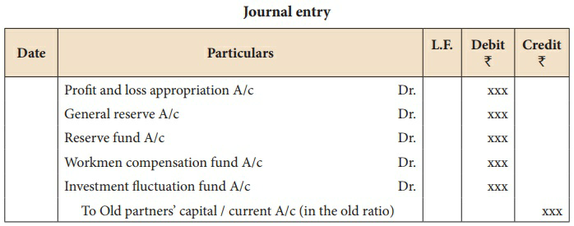
ACCOUNTING TREATMENT OF ACCUMULATED PROFITS AND LOSSES
(a) For transferring accumulated profit and reserves

Slide 11
(b) For transferring accumulated loss

Slide 12
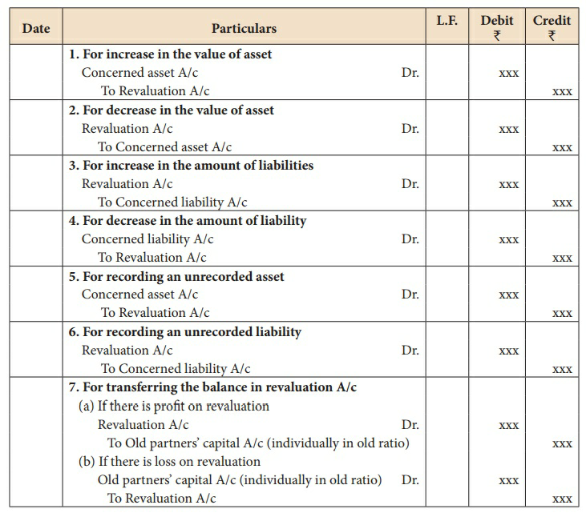
ACCOUNTING TREATMENT OF REVALUATION OF ASSETS AND LIABLITIES
Following are the journal entries to be passed

Slide 13
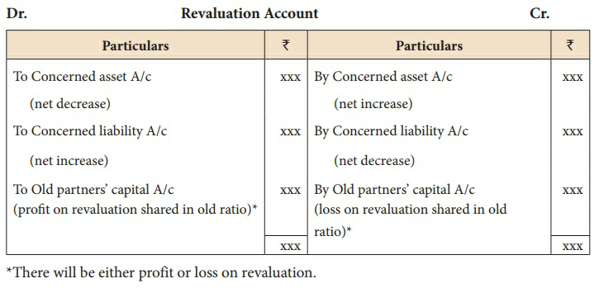
FORMAT OF REVALUATION ACCOUNT

