Slide 1

Good Morning
Children

Slide 2
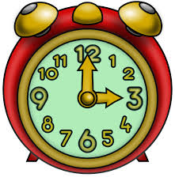
TIME

Slide 3
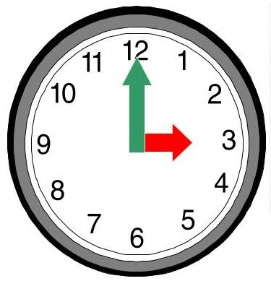
Telling The Time
In hours
The long hand is the minute hand.
The short hand is the hour hand.
The hour hand is at 3 in this clock.
The minute hand is at 12.
So the time is 3:00 or 3 o’clock.

Slide 4
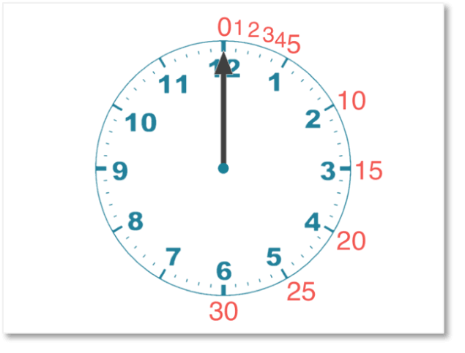
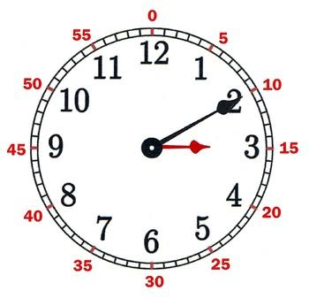
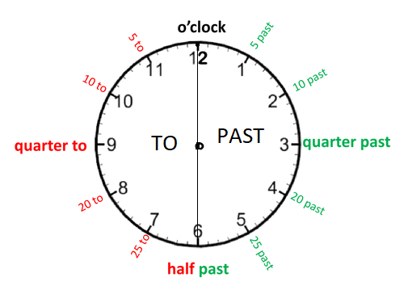
Telling the time to the nearest 5 minutes
The minute hand moves from one digit to the next in 5 minutes.
When the minute hand is on 1, it shows 5 minutes past the hour.
When the minute hand is on 2, it shows 10 minutes past the hour.
And so on.
Minute hand on the right of the clock .. minute PAST
Minute hand on the left of the clock…minute TO

Slide 5



In half hours
When the minute hand is on 6, the time is in half hours.
The hour hand is between 5 and 6 in this clock.
The minute hand is at 6. So the time is 5:30 or half past 5.
Quarter past
When the minute hand is at 15.
We say 4:15 or quarter past 4.
Quarter to
When the minute hand is at 45.
We say 1:45 or quarter to 2.

Slide 6
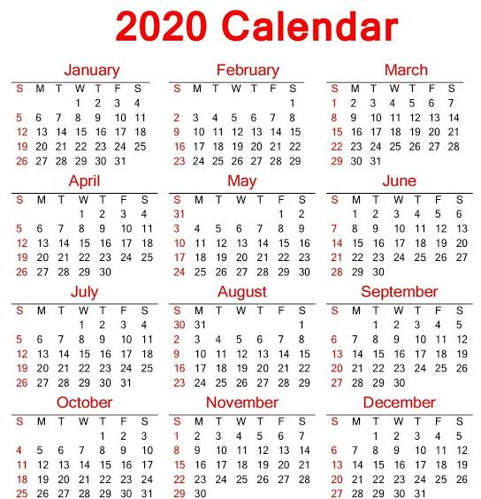
CALENDAR
A year has 12 months or 365
days.
A week is of 7 days.
A month has 4 weeks and few
more days.
A leap year has 366 days.
February has 29 days in a leap
year.

Slide 7
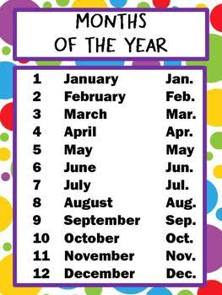
The first month of the
year is January.
The last month of the
year is December.

Slide 8
Thank You
Children

