Slide 1

GOOD MORNING
CHILDREN

Slide 2

MONEY

Slide 3
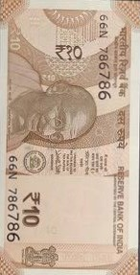
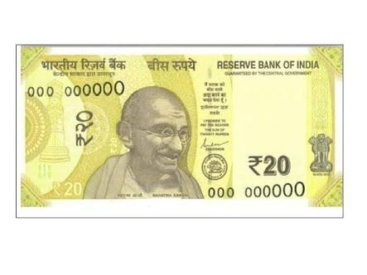

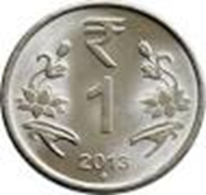
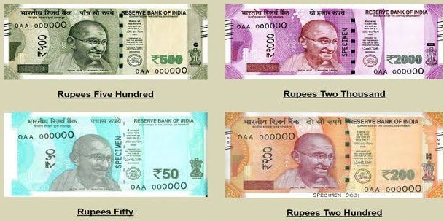



Money is a medium of exchange.
We use money for buying goods.
COINS
NOTES

Slide 4
Writing Rupees And Paise
How do we write money in words and figures ?
For example : ₹ 5.50
In words - 5 rupees and 50 paise
In figures - ₹ 5.50
The dot (.) seperates the rupees and the paise.
The number to the left of the dot shows the rupees.
The number to the right of the dot shows the paise.

Slide 5
Conversion Of Rupees And Paise
Converting rupees into paise
1 rupee = 100 paise
To convert rupees and paise into paise
Remove ₹ and the dot (.). Write p for paise at the end.
For example : ₹ 6.50 = 650 p
To convert rupees into paise
Multiply the amount in rupees by 100.
For example : ₹ 3 = 3 X 100 = 300 p

Slide 6
Converting paise into rupees
Converting paise into rupees
Count 2 digits from the right and put a dot there,
Write ₹ at the beginning.
For example : 275p = ₹ 2.75
Do not put ‘p’ after the dot. (2.75p X )

Slide 7
Add ₹ 83.75 and ₹ 10.50
Arrange in ₹ and p
Write in columns such that the dots are
exactly one below the other.
Add the paise first
75p + 50p = 125p (100p=₹1)
100p + 25p = ₹1 + 25p
and then the rupees ₹83 + ₹10 + ₹1 = ₹94
The result is ₹ 94.25
1
₹ 8 3 . 7 5
+ ₹ 1 0 . 5 0
_________
₹ 9 4 . 2 5
__________

Slide 8
Subtract ₹ 70.25 from ₹ 90.00
Arrange in ₹ and paise
Write in columns such that the dots are
exactly one below the other.
Subtract the paise first
₹1 is borrowed from ₹90 (₹1=100p)
100p - 25p = 75p
and then the rupees
₹90 reduced to ₹89
₹89 - ₹70 = ₹19
The result is ₹ 19.75
₹ 9 0 . 0 0
- ₹ 7 0 . 2 5
_________
₹ 1 9 . 7 5
__________

Slide 9
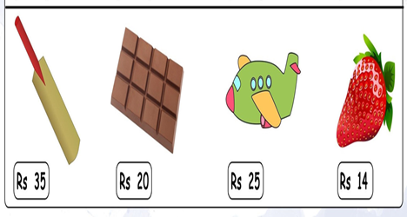
Sharon bought some items from Queen’s Corner. How much money did she spend in all ?
ITEM | QUANTITY | AMOUNT
Bat | 1 | ₹35
Chocolate | 2 | ₹40
Toy Aeroplane | 3 | ₹75
Strawberry | 2 | ₹28
 | TOTAL | ₹178
Sharon spent ₹178 for all the items.

Slide 10

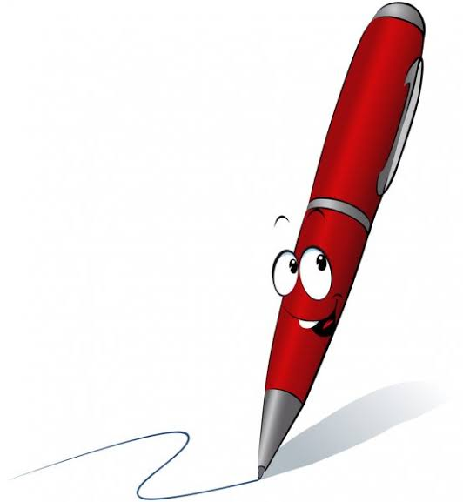
Word Problem
Meera bought a story book for ₹ 85 and a pen for ₹ 15.50.
How much money did she spend in all ?
Cost of the story book = ₹ 8 5 . 0 0
Cost of the pen = + ₹ 1 5 . 5 0
_________
Money spent in all = ₹ 1 0 0 . 5 0
__________
Ans. Meera spent ₹ 100.50 in all.

Slide 11
THANK YOU
CHILDREN

