Slide 1
Chapter 2:
Using the Internet

Slide 2
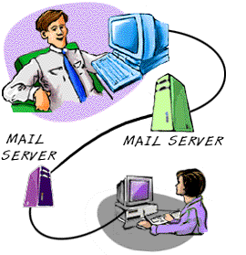
Electronic Mail
Electronic mail or e-mail is a message sent from one computer to another through the internet.
Email is cheaper and easier to use than a letter sent by post.
You can send the same email to a number of people at the same time.
You need to create an email account to send an email.
Gmail, Yahoo and Rediff are websites that provide free email service.

Slide 3
Advantages of using email
Emails are the fastest mode of written communication.
You can send and receive them anywhere using any kind of computer or smartphone.
You can send an email to multiple recipients at the same time.

Slide 4
How to create an email account
Step 1: Connect to the internet and open any web browser.
Step2: Type www.gmail.com in the address bar and press the Enter key.
The Gmail window opens. Click on create account.
Step3: A new window opens asking you to fill in information about yourself.
Step4: Type your first name and your last name.
Step5: Think of a username. A username is the name you choose for yourself while opening an account online. It can be your name or a combination of some letters and a number. In Gmail, your username is also your email address.
Step6: Think of a password.
Step7: Type the remaining details and click on the Next step button. A new window appears.
Step8: Click on “I AGREE”
Step9: A welcome screen appears. Click on Continue to Gmail. It will take you to the Inbox of your email account.

Slide 5
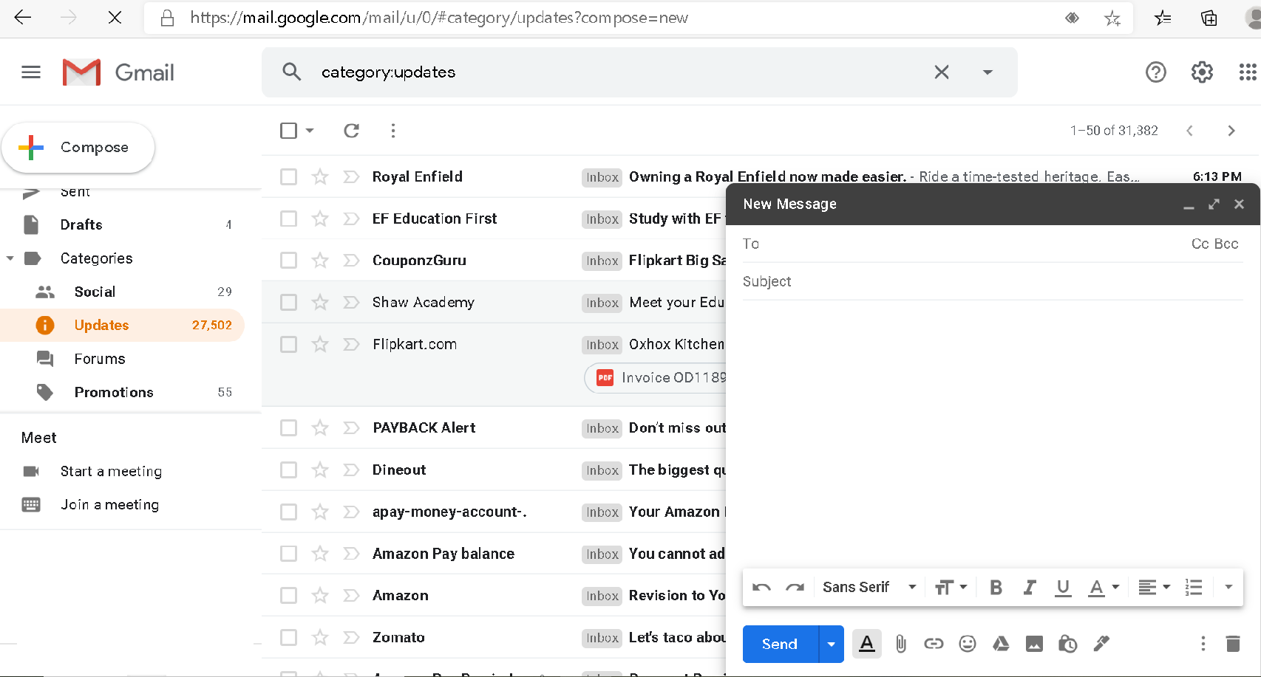
Composing and sending an email
Type the email address of the person here
To compose a new email, click the compose button
Write a suitable subject
Write your email here
…………………………………………………………………………………………………………………………………………………………………………………………………………………………………………………………………………………......................................................................................................................................................................................................
To send the email click the SEND button

Slide 6
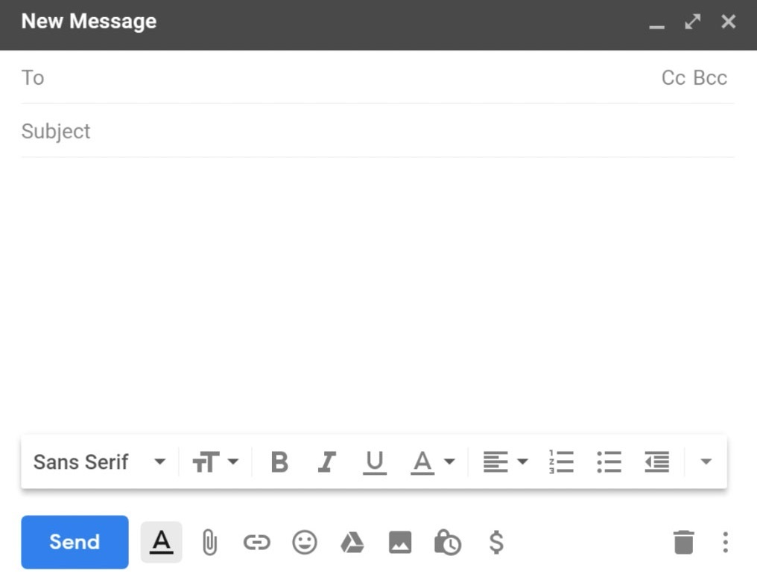
You can send an email to many people at the same time. For this you can use the Cc and Bcc options.
Cc stands for Carbon Copy. It displays the email addresses of all the recipients.
Bcc stands for Blind Carbon Copy. It hides the email addresses of the recipients from each other

Slide 7
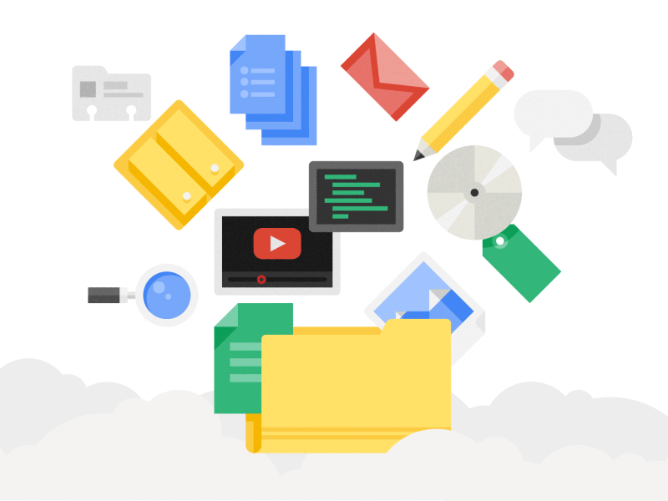
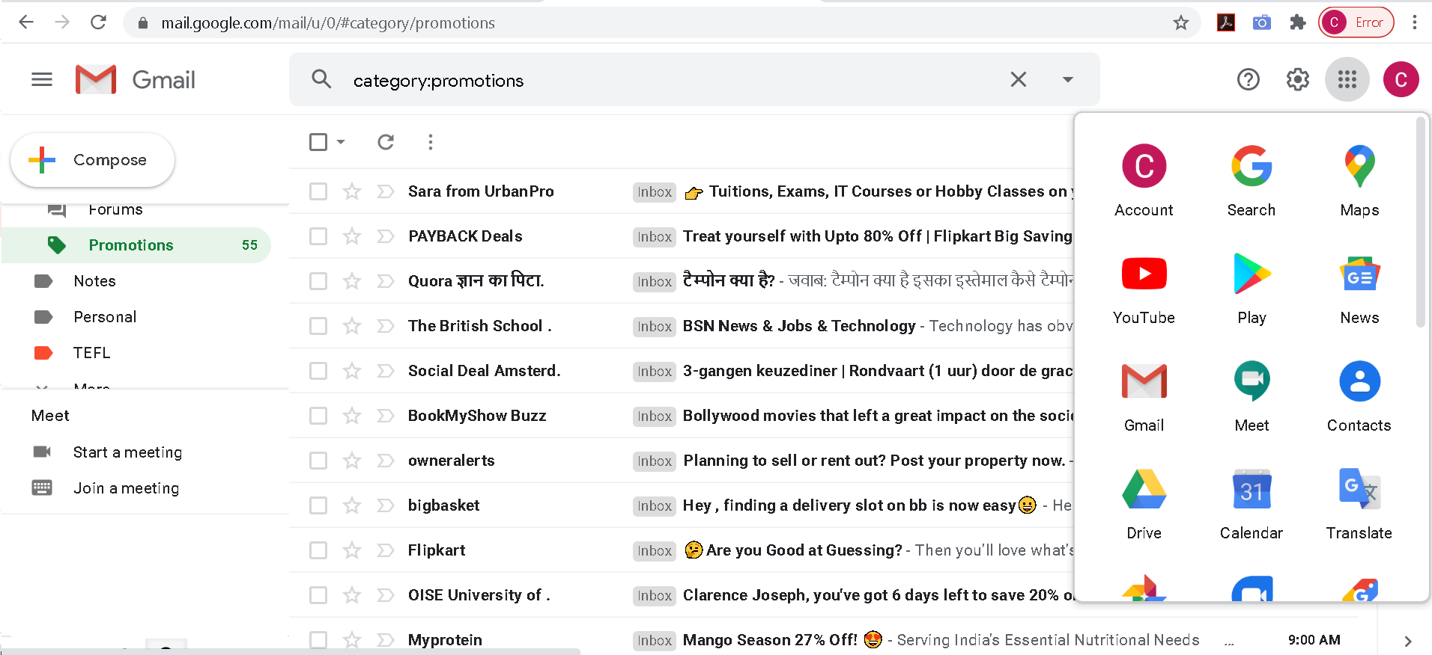
Google Drive
Google drive is a free online service. It offers 15 GB of free storage space. You can use it to create and store documents, spread sheet presentations and applications. The information stored on it can be used and accessed from any device that can access the Internet.

Slide 8
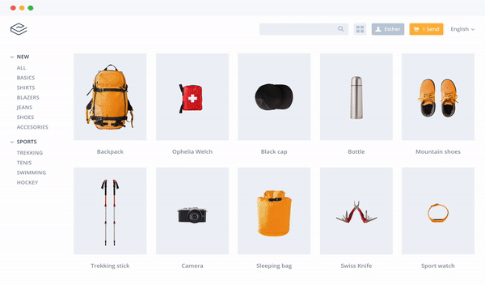
E-Commerce
E-commerce stands for electronic commerce. It includes the buying and selling of goods using the Internet. E-commerce includes online shopping, ticket booking, bill payments and so on.
Advantages of e-commerce
It reduces the use of paper.
It provides quicker delivery of products.
It provides easy access to a vast number of online services.

Slide 9
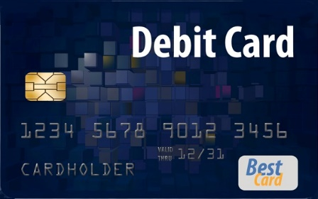
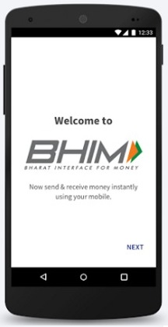
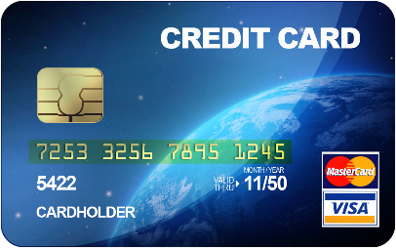
Online Modes of Payment
Debit Card: A debit card is issued by the bank in which you have an account. When you use a debit card to pay, the amount gets deducted from your bank account at that time. There should be sufficient balance in your bank account for you to use it to pay.
Credit Card: When you use a credit card to pay, the bank gives the money. This is the bank that had issued you the credit card. You have to return the money to the bank within a certain period of time.
BHIM (Bharat Interface for Money) is a Mobile App launched by the Government of India. It allows the user to instantly transfer money between the bank accounts of two parties.
There are a number of ways you can use to pay for a product purchased online:

Slide 10
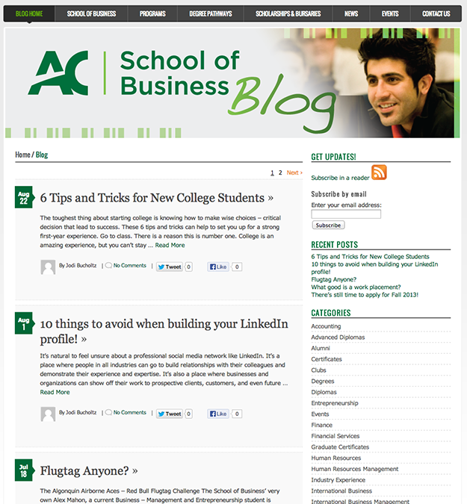
Blog
A blog is a means of communication that can have text, image, video, audio and so on. You can use a blog to share your ideas with online readers. The readers of the blog can comment on the blog.
Some key features of a blog are as follows:
A blog is normally a single page of entries. The entries are displayed in reverse.
A blog is usually public. Anyone can see it.
Blogs generally contain text. However, there are vlogs (video blogs), photologs (photograph blogs) and podcasts (audio blogs).
Microblogging: It is an upcoming practice in which small pieces of information are posted on the Internet. It is mostly used for news updates. Some microblogging websites are Twitter, Tumblr and FriendFeed.

Slide 11
BLOG | WEBSITE
1. A blog is a type of website. | A website is a collection of related web pages.
2. The language used is often simpler than that of a website. | The language used is formal.
3. Blogs are interactive and you can write about your area of interest. | There is no interaction in a website.
4. The content in a blog is regularly updated. | The major content of a website remains the same.

Slide 12
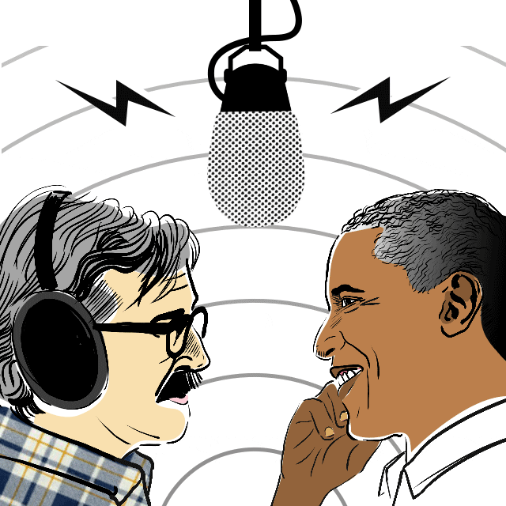
Podcast
A podcast is the audio form of a blog. A podcast is recorded and stored on a website. You can listen to a podcast directly from the website on which it is uploaded. You can also share and listen to a podcast on a computer or smartphone.
Advantages of podcasts
1. Podcasts can be easily transferred from one computer to another.
2. Since a podcast is available online, you can listen to it whenever you want.

Slide 13
PODCAST | BLOG
1. You listen to a podcast. | You read a blog.
2. You use an audio media player or smartphone to listen to a podcast | You use a computer or a smartphone to read a blog.
3. A podcast file can be easily downloaded. | Blog files cannot be downloaded.

Slide 14
Safe Internet Use
Never share personal information such as your name, address and phone number.
Remember people are not always who they say they are.
Never agree to meet someone in person that you have met online.
Always keep your password a secret.
Do not open emails from people you do not know.
Do not accept any offer that seems to good to be true.
Always check with your parents before you post your photographs or those of others.
Never post something you would not say in real life.
Always be honest with your parents about your activities on the Internet.
Spend more time with your family, friends and school work than you do on your computer.

Slide 15
THANK YOU STUDENTS!

