Slide 1
NERVOUS SYSTEM
Class – 7
Subject – BIOLOGY
Part - 3

Slide 2
PERIPHERAL NERVOUS SYSTEM (PNS):
It includes the nerves which are divided into two types:
PNS
Cranial nerves
(arising from brain)
Spinal nerves
(arising from spinal cord
These nerves emerge from the brain and supply to different parts of head. There are 12 pairs of cranial nerves.
These nerves emerge from the spinal cord and supply to the different parts of body. There are 31 pairs of spinal nerves.

Slide 3
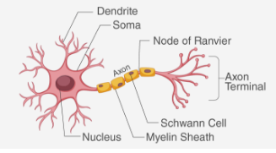
NEURON :
Nervous system is made-up of highly specialised cells called neurons. It is the smallest functional unit of the nervous system.
Parts of Neuron:
Each nerve cell has a cell body (main part) called cyton, finger like extensions from cyton called dendrons or dendrites and a long wire like extension called an axon which carries the impulses from place to place. This axon ends in the form of synaptic knobs. Dendrites of one cell almost touch the synaptic knob of the next cell. At this point there is a small gap called synapse.

Slide 4
Types of Neurons:
Neurons
Receptor or Sensory Neurons
Effector or Motor Neurons
Relay or
Connecting or Inter Neurons
Carry impulses from receptors to the central neurons.
Carry impulses from central nervous system to effectors.
Carry impulses from receptor neurons to effectors or from one relay neuron to another
(e. g., in brain)

Slide 5
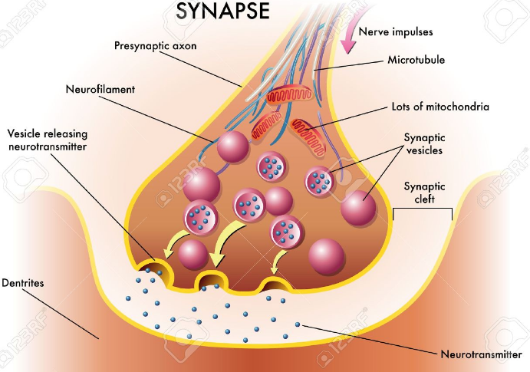
Activity 4: To understand the role of synapse
Minute gaps called synapses separate the neurons from one another. Each synapse separates the ends of the axon of one neuron from the dendrites of the next.
When nerve impulses arrive at the end of the axon they stimulate the production of a special chemical called neurotransmitter (e.g., acetylcholine) which diffuses across the synapse to the dendrites of neibouring neurons.
The final destination of nerve impulses is either a muscle or a gland. When stimulated by impulses, muscle contract and glands produce hormones or enzymes.

Slide 6
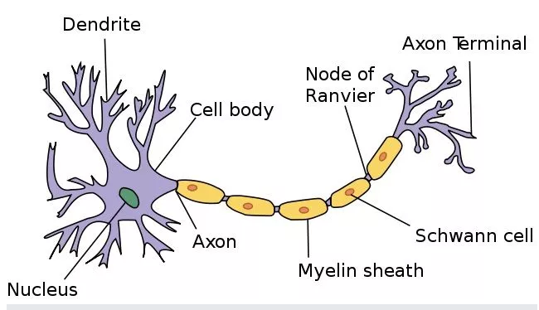
Activity 5: To know functions of various parts of a neuron
Cell body – The main part of the neuron consisting of cytoplasm and nucleus.
Dendrites - Short, branched process which receive nerve impulses and transmit them towards the cell body. They are grey in colour and make up the grey matter of the brain and spinal cord.
Axon – Single, longest, unbranched process which transmits impulses away from the cell body to the target cell. They are white in colour and make up white matter of brain and spinal cord.
Myelin sheath – Made up of individual cells (Schwann cells) with abundant fatty materials surrounding the axon, acts as an electrical insulator and speeds up the passage of impulses.
Nodes of Ranvier – The gaps between the Schwann cells (which form the myelin sheath) where the myelin sheath is absent.

Slide 7
End of Part – 3.

