Slide 1

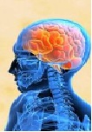
NERVOUS SYSTEM
Class – 7
Subject – BIOLOGY
Part - 4

Slide 2
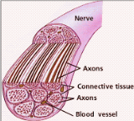
T
NERVES
Neurons (nerve fibres) group together to form a nerve. A nerve is formed of a bundle of axons (nerve fibres) which are enclosed in a tubular medullary sheath. This sheath over the axon acts like an insulation and prevents mixing of impulses (signals) in the adjacent fibres. Nerves are spread out in all parts of the body.

Slide 3
TYPES OF NERVES
Nerves are divided into three types:
NERVE

Slide 4
TYPES OF NERVES
Nerves are divided into three types:
NERVE
Sensory Nerves

Slide 5
TYPES OF NERVES
Nerves are divided into three types:
NERVE
Sensory Nerves
Motor Nerves

Slide 6
TYPES OF NERVES
Nerves are divided into three types:
NERVE
Sensory Nerves
Motor Nerves
Mixed nerves

Slide 7
TYPES OF NERVES
Nerves are divided into three types:
NERVE
Sensory Nerves
Motor Nerves
Mixed nerves
It contain only sensory neurons, e. g, the optic nerve that transmits impulses from the retina of the eye to the brain. (carry nerve impulse from different parts of the body to brain and spinal cord).

Slide 8
TYPES OF NERVES
Nerves are divided into three types:
NERVE
Sensory Nerves
Motor Nerves
Mixed nerves
It contain motor neurons, e.g., cranial nerves (leading from the brain) (carry nerve impulse from brain and spinal cord to the body parts like muscles and glands).

Slide 9
TYPES OF NERVES
Nerves are divided into three types:
NERVE
Sensory Nerves
Motor Nerves
Mixed nerves
It contain both sensory and motor neurons, e.g., Spinal nerves (leading from the spinal cord).

Slide 10
TYPES OF NERVES
Nerves are divided into three types:
NERVE
Sensory Nerves
Motor Nerves
Mixed nerves
It contain only sensory neurons, e. g, the optic nerve that transmits impulses from the retina of the eye to the brain. (carry nerve impulse from different parts of the body to brain parts of the body to brain and spinal cord.
It contain motor neurons, e.g., cranial nerves (leading from the brain) (carry nerve impulse from brain and spinal cord to the body parts like muscles and glands.
It contain both sensory and motor neurons, e.g., Spinal nerves (leading from the spinal cord.)

Slide 11
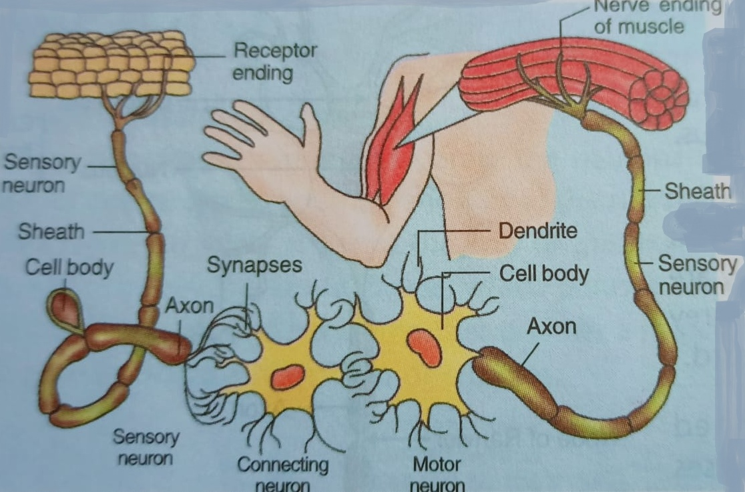
TYPES OF NERVES
Sensory neurons send impulses from receptors towards Central Nervous System (CNS). Connecting neurons provide the link between sensory and motor neurons. Motor neurons carry impulses from connecting neurons (with CNS) to the muscles and glands.

Slide 12
Functions of the nerves
Receive stimuli from the environment. In multicellular organisms, this is done by modified nerve cells called receptors.
Convert the stimuli into the form of electrical impulses a process called transduction.
Transmit them , often over considerable distance to other specialised cells called Effectors which are capable of producing an appropriate response.
Nerve impulses
Unlike the electrical impulses that are sent along the telephone line, nerve impulses are caused by chemical changes in and around the neuron.
Nerve impulses travel rapidly in one direction, starting at the dendrites and finishing at the end of the axon.

Slide 13
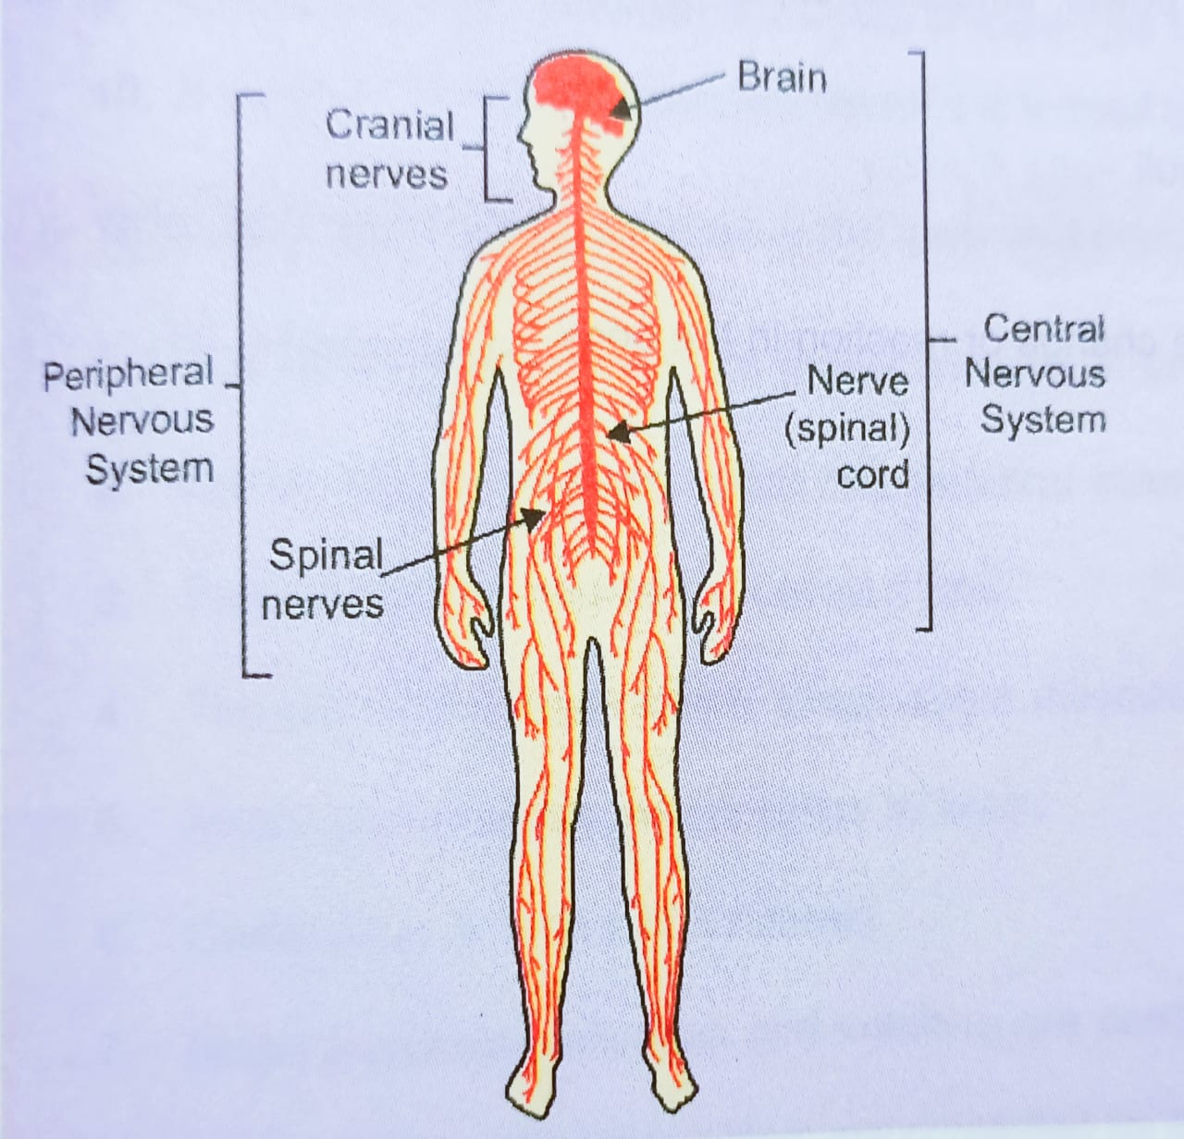
Activity 6 : To understand the network of various types of nerves in our body

Slide 14
AUTONOMIC NERVOUS SYSTEM (ANS)
Autonomic Nervous System
Sympathetic System
(Stimulatory in action)
Parasympathetic System
(inhibitory in action)
The activities of internal organs like heart, blood vessels, smooth muscles, glands are controlled by another specific set of nerves that form the autonomic nervous system.

Slide 15
End of Part – 4.

