Slide 1

CLASS --- VIII
CHAPTER 3 ---- FUNCTIONS AND CHARTS IN EXCEL

Slide 2
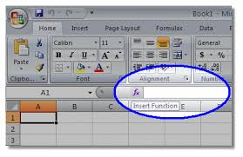
FUNCTIONS
ARGUMENTS
A predefined formula in Excel is known as function.
Values on which operations are performed are called arguments.

Slide 3
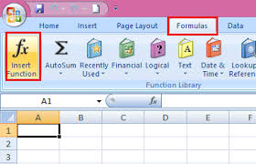
INSERTING FUNCTIONS
Functions can be inserted from the formulas tab.
A function always begins with an equals sign (=).
Function arguments are given in small brackets ( ) after the function name.

Slide 4
Commonly used functions
MATHEMATICAL FUNCTIONS
STATISTICAL FUNCTIONS

Slide 5
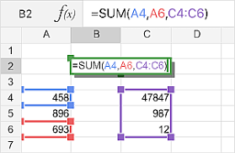
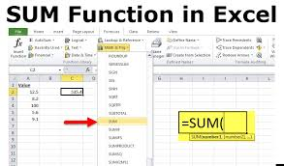
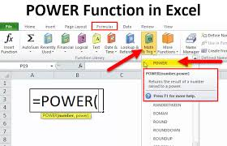
MATHEMATICAL FUNCTIONS
SUM, PRODUCT, QUOTIENT, POWER

Slide 6
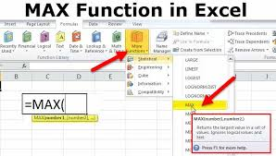
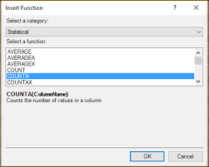
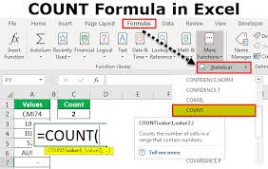
STATISTICAL FUNCTIONS
MAX, MIN, COUNT, COUNTA, AVERAGE

Slide 7
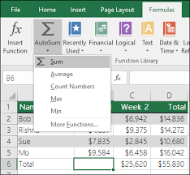
AUTOSUM
AutoSum is used to insert commonly used functions such as Sum, Average, Max, Min and Count Numbers.

Slide 8
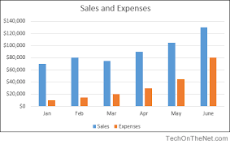
CHARTS IN MS-EXCEL
A chart is a graph on an Excel worksheet used to represent data in a pictorial form.

Slide 9
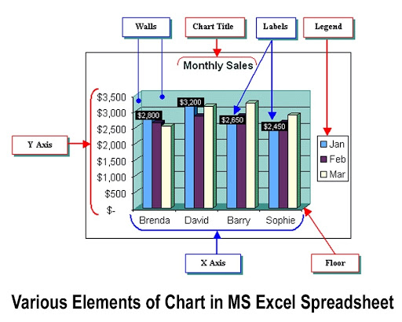
COMPONENTS OF A CHART

Slide 10
Chart Elements
The title is a text box you can place anywhere on the chart.
The plot is the area on the chart that displays the data in the chart type you choose.
A data point is one piece of data appearing on the chart. For most chart types, each data point shows the value of the contents of one cell in the data range linked to the chart.
A chart's legend shows what each color on a chart represents.
Gridlines are the lines on a chart added to improve its readability.
X-axis (Category axis) is the horizontal axis displaying the categories.
Y-axis (Value axis) is the vertical axis displaying values.

Slide 11
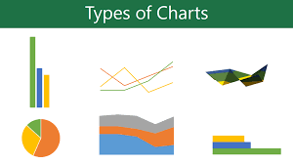
TYPES OF CHARTS
Column
Line
Pie
Bar
Area

Slide 12
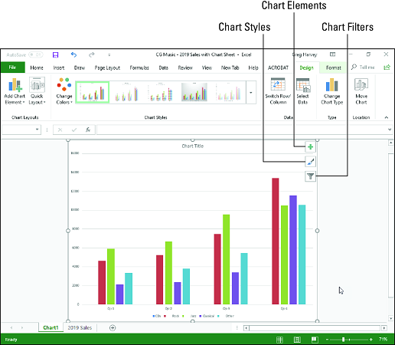
It compares data using vertical bars.
COLUMN CHART

Slide 13
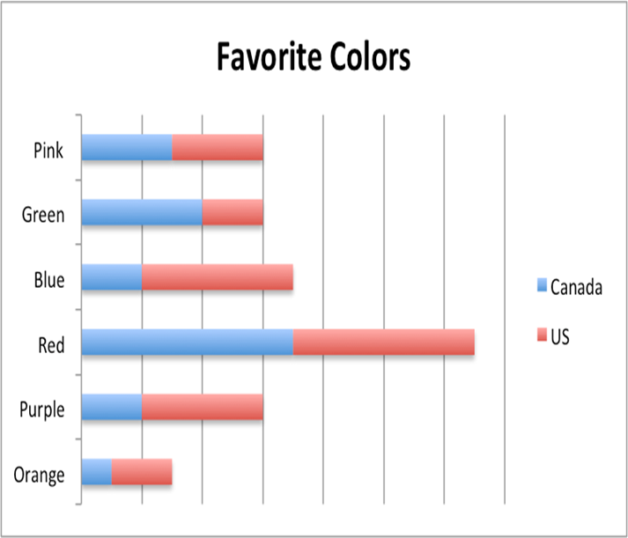
It compares data using horizontal bars.
BAR CHART

Slide 14
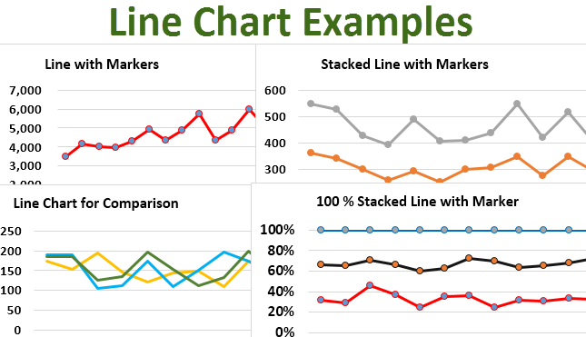
It shows trends over time using lines.
LINE CHART

Slide 15
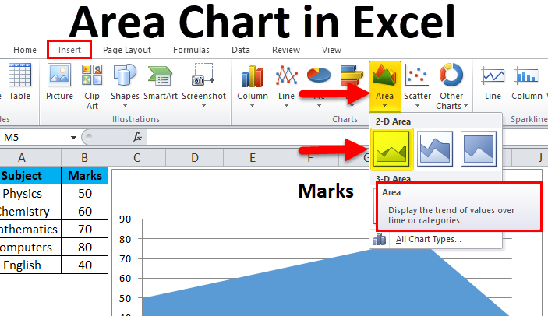
It is similar to a line chart with areas under the lines filled in.
AREA CHART

Slide 16
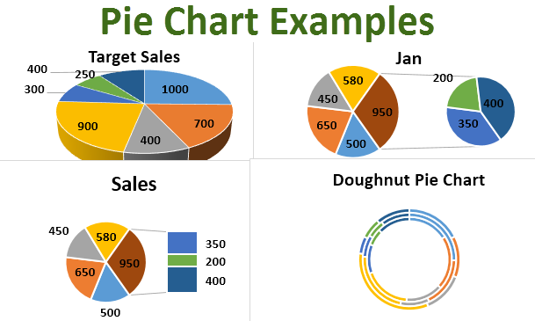
It compares proportions or parts of a whole.
PIE CHART

Slide 17
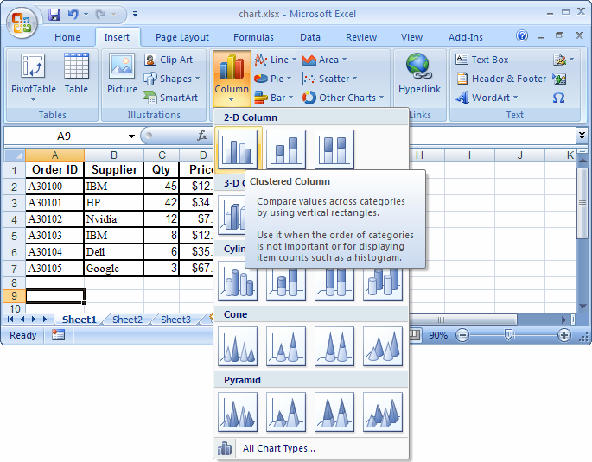
In MS-Excel you can-------
Create, Modify, Delete, Move or Resize a chart

Slide 18
THANK YOU

