Slide 1

SUBJECT-SCIENCE
TOPIC-FOOD WE EAT AND DRINK

Slide 2
FOOD
We need food to live. Food gives us energy to work, it keeps us healthy and helps us to grow.

Slide 3
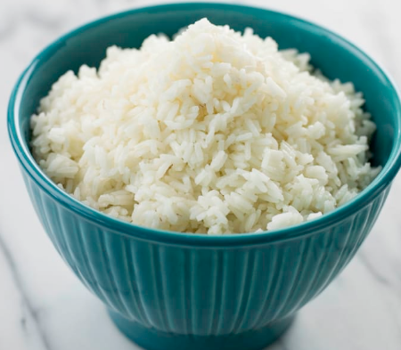
FOOD WE EAT
Rice

Slide 4
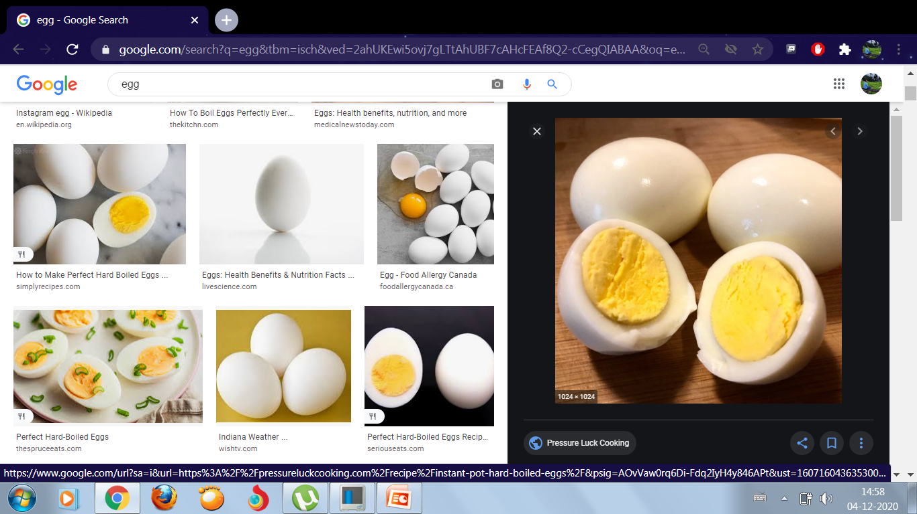
Egg

Slide 5
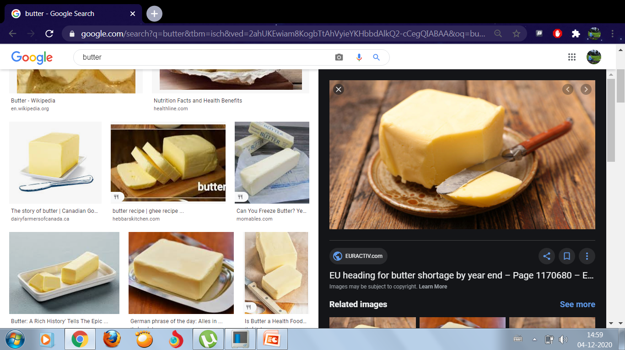
Butter

Slide 6
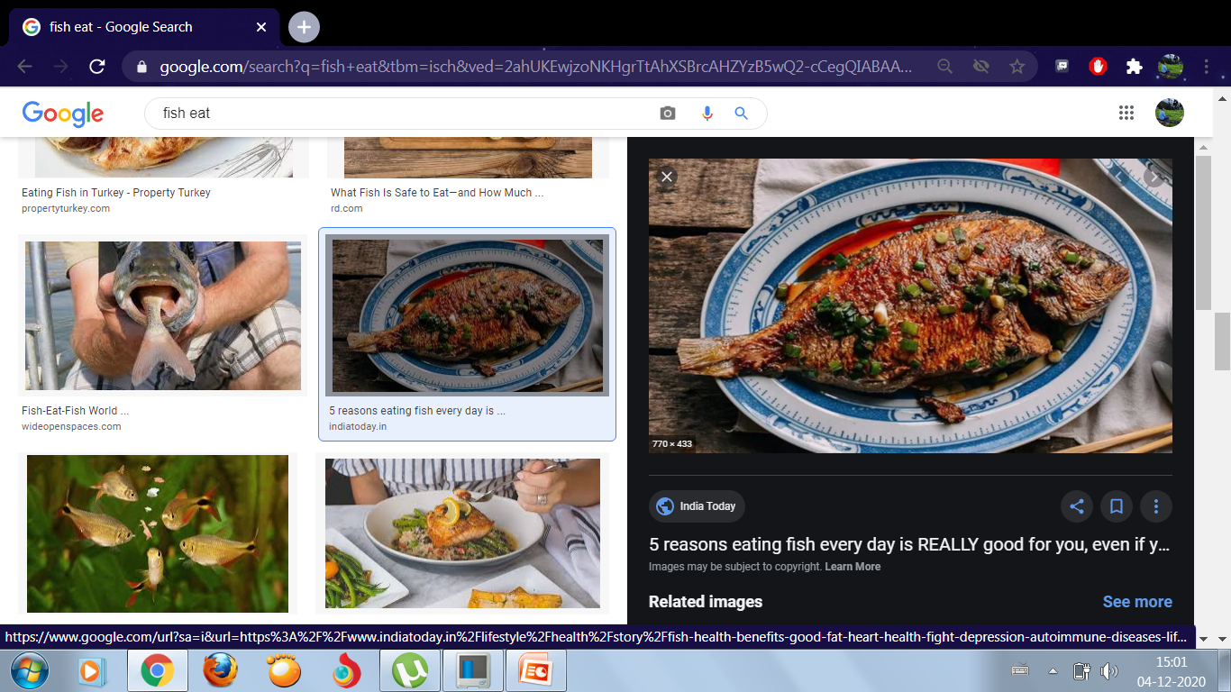
Fish

Slide 7
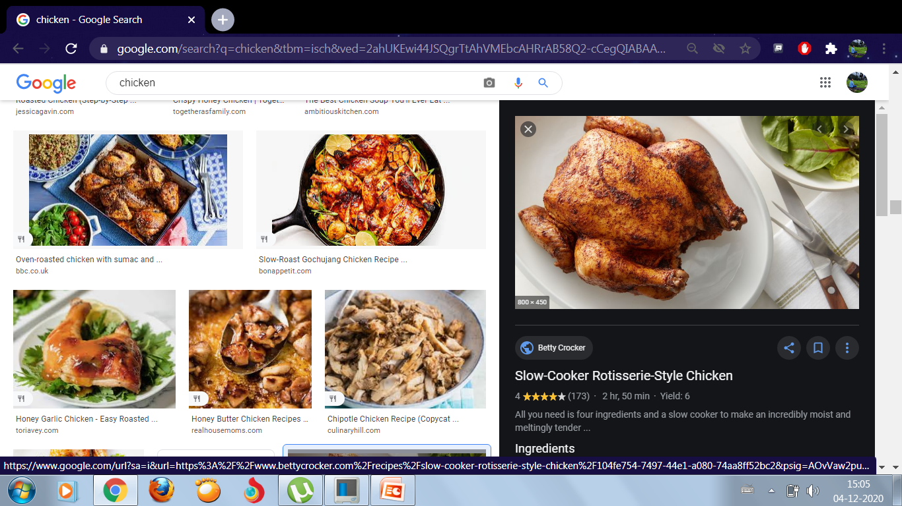
Chicken

Slide 8
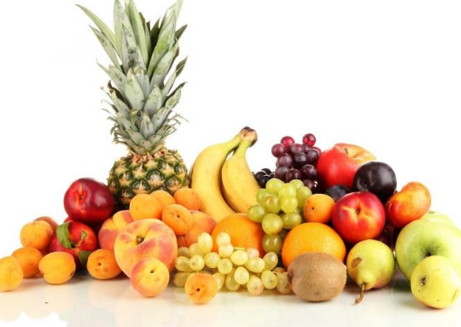
Fruits

Slide 9
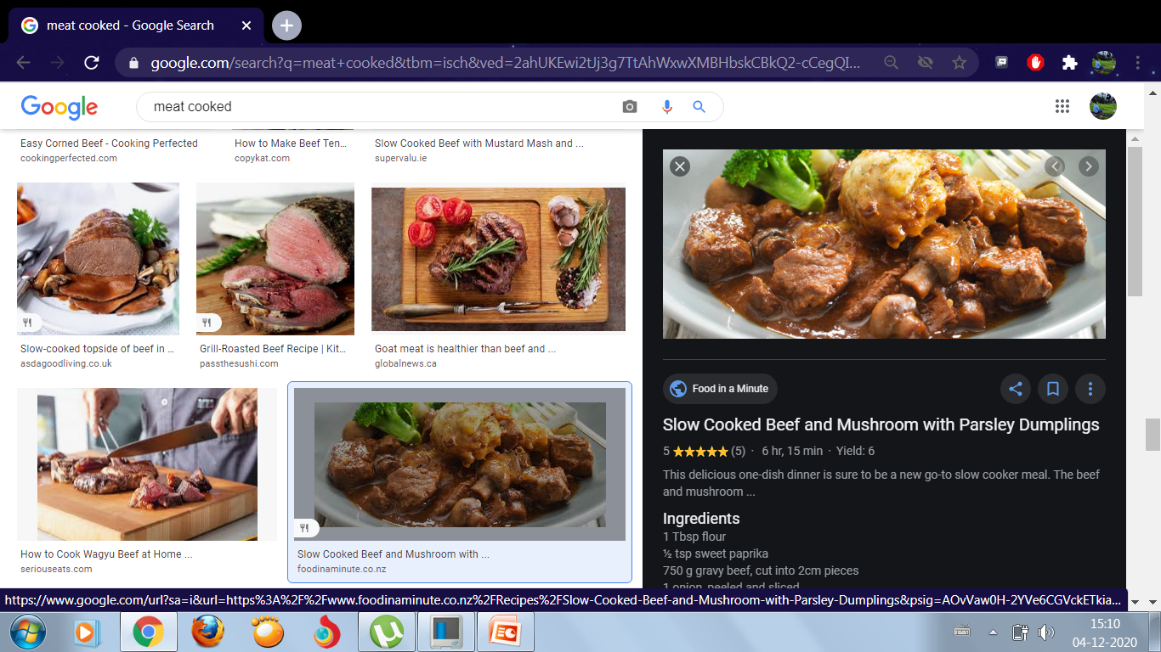
Meat

Slide 10
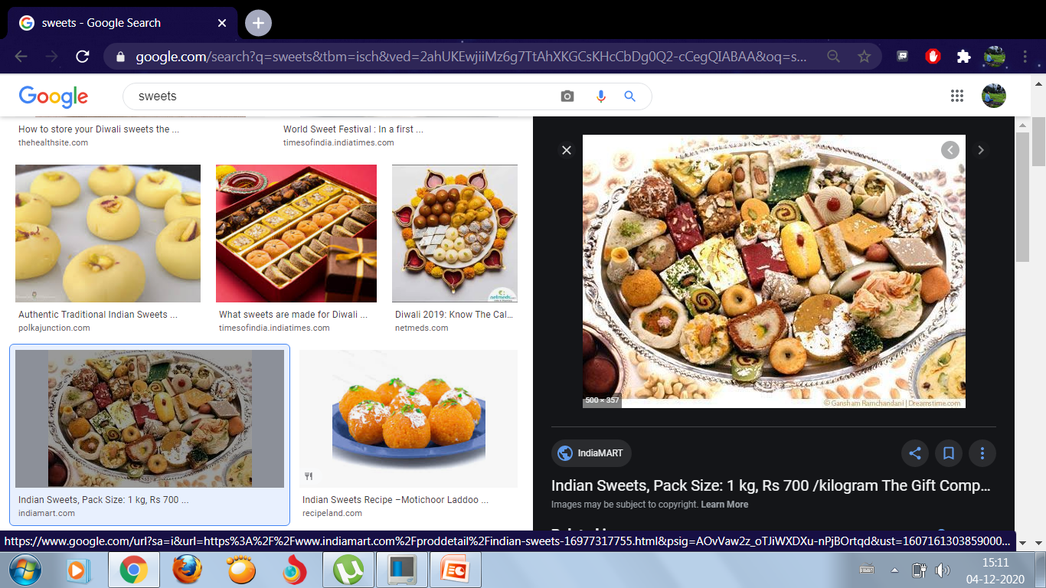
Sweets

Slide 11
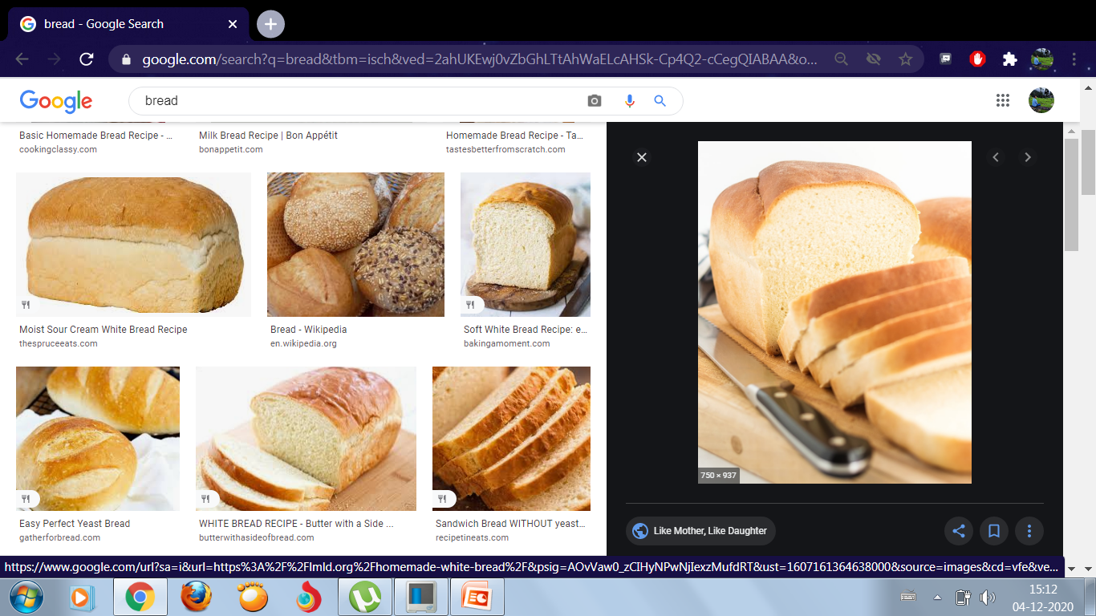
Bread

Slide 12
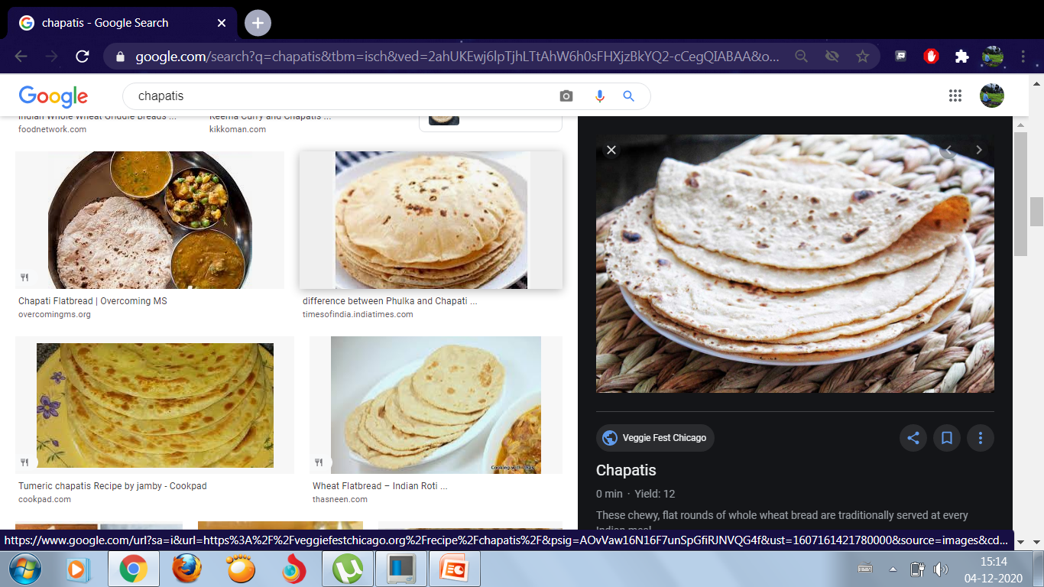
Chapatis

Slide 13
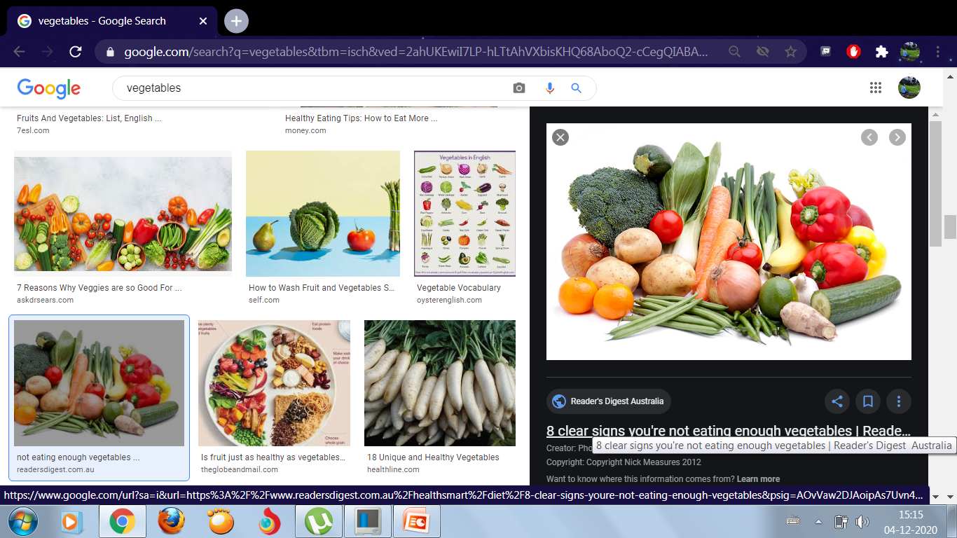
Vegetables

Slide 14
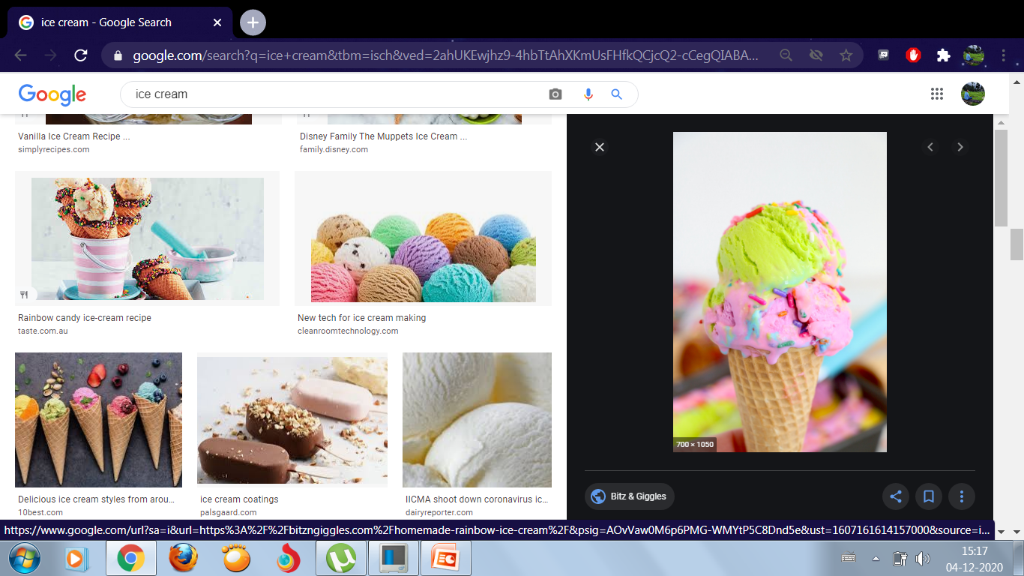
Ice-cream

Slide 15
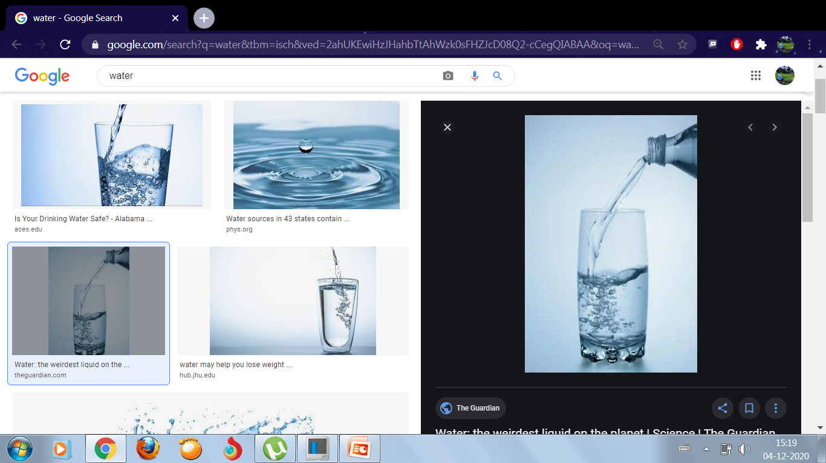
FOOD WE DRINK
Water

Slide 16
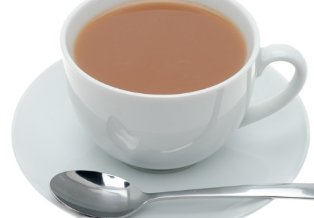
Tea

Slide 17
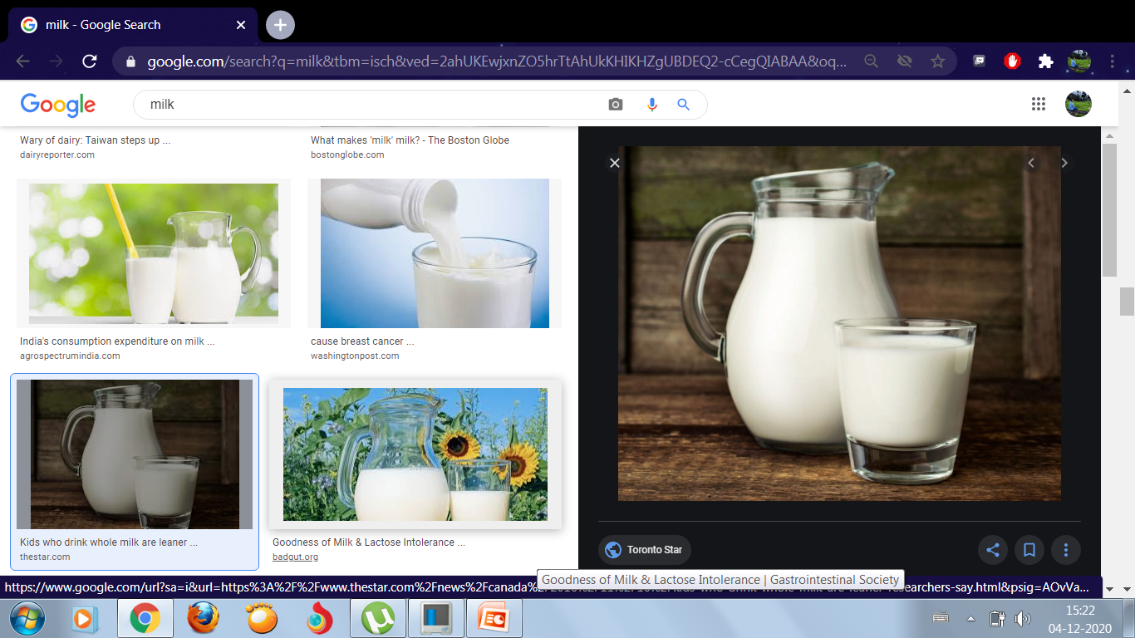
Milk
Drinking milk is good for health.

Slide 18
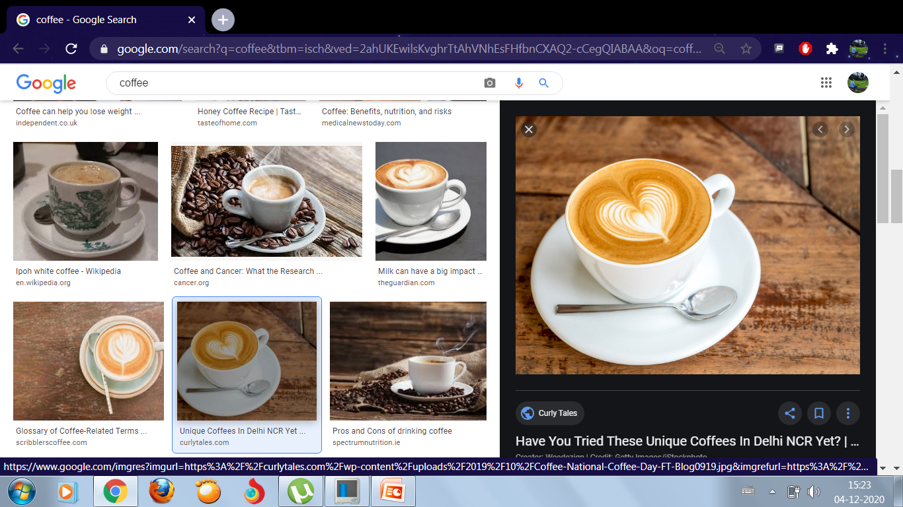
Coffee

Slide 19
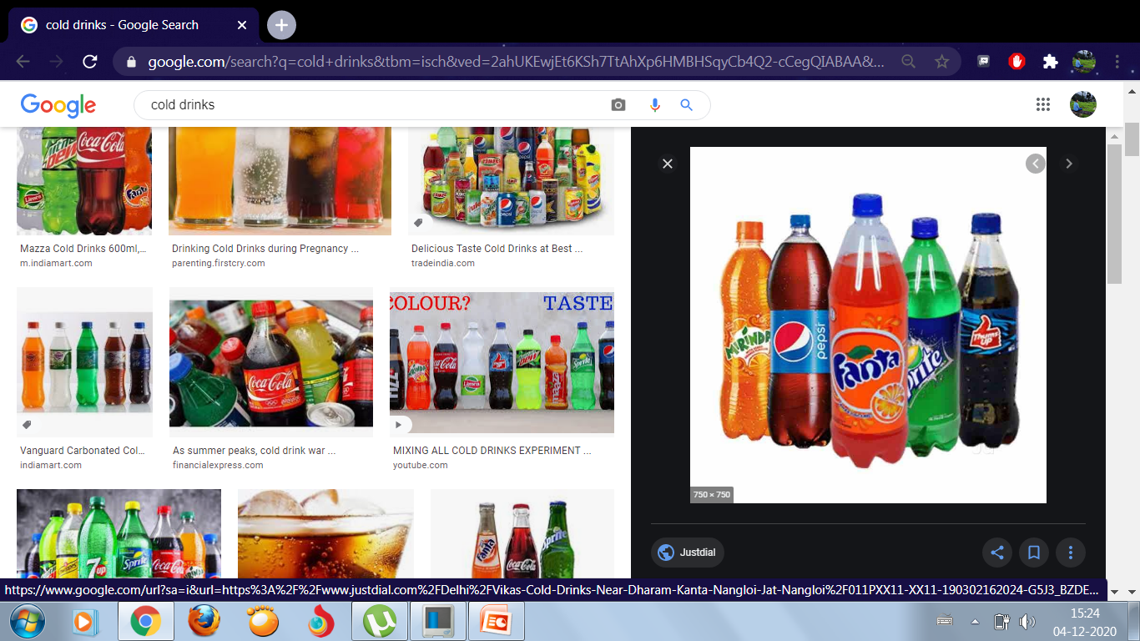
Cold drinks

Slide 20
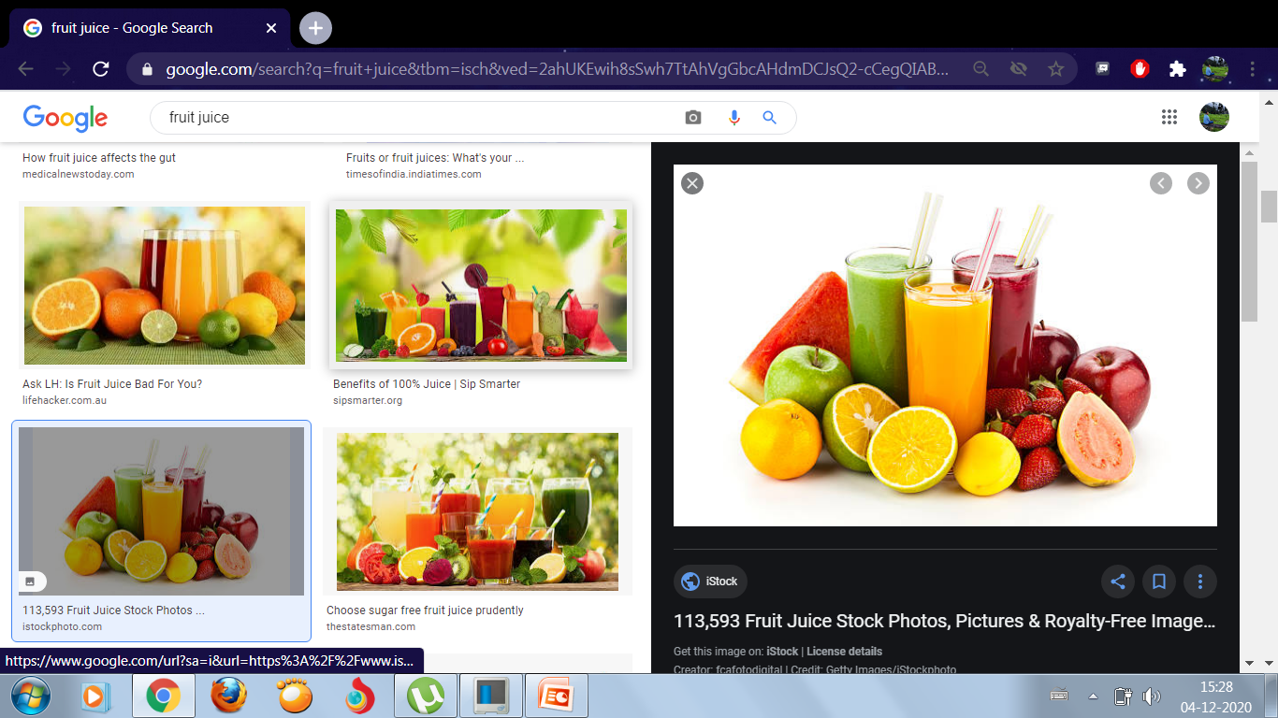
Fruit juice

Slide 21
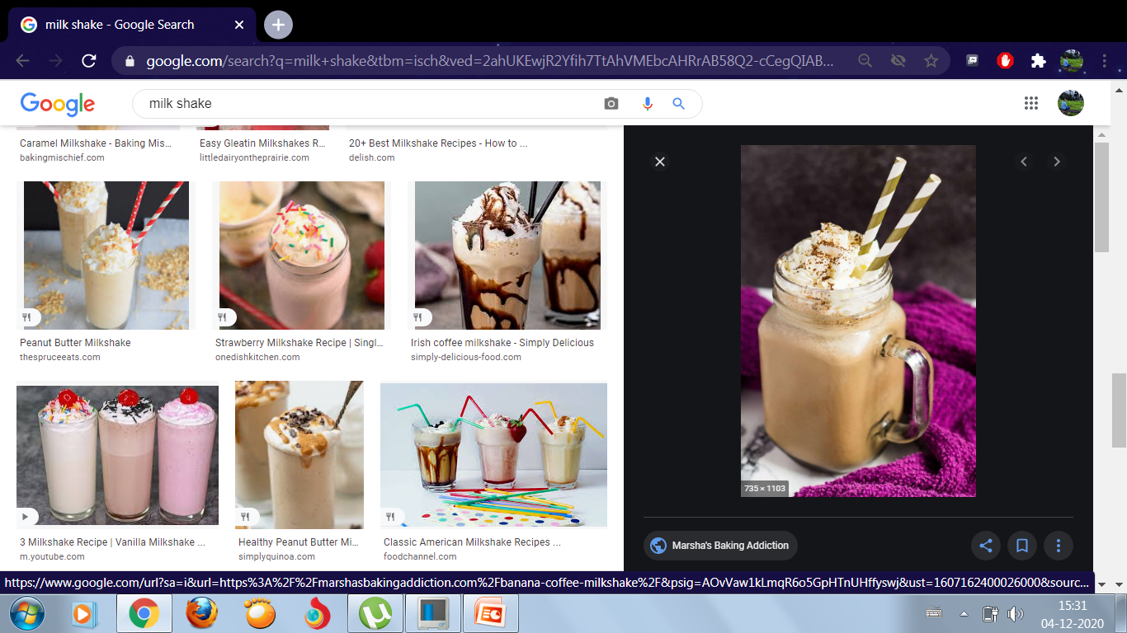
Milk shake

Slide 22
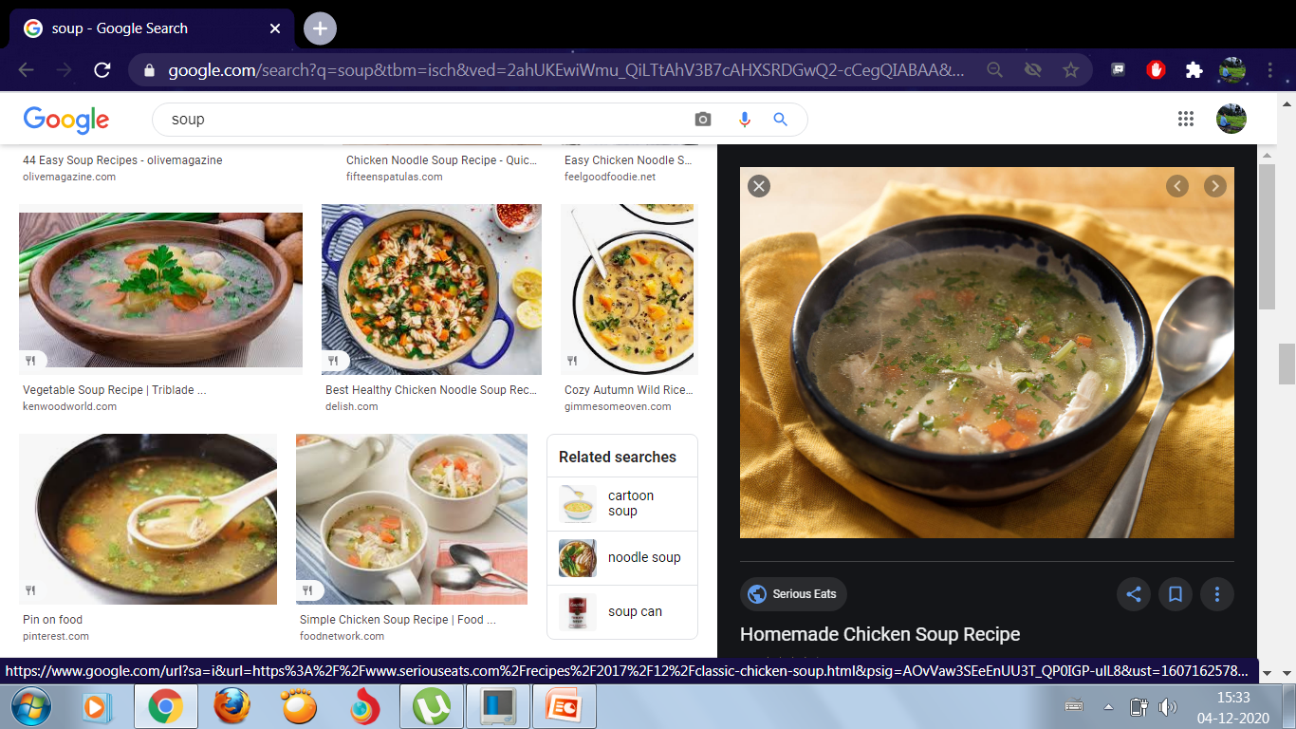
Soup

Slide 23
WORK TO DO
Q1) Look at pictures and write down the names of the food we eat and drink.
Q2) Match the following.
Q3) Write down the names of 12 food we eat.
Q4) Write down the names of 8 food we drink.

Slide 24
