Slide 1

SUBJECT-SCIENCE
TOPIC-PARTS OF THE BODY

Slide 2
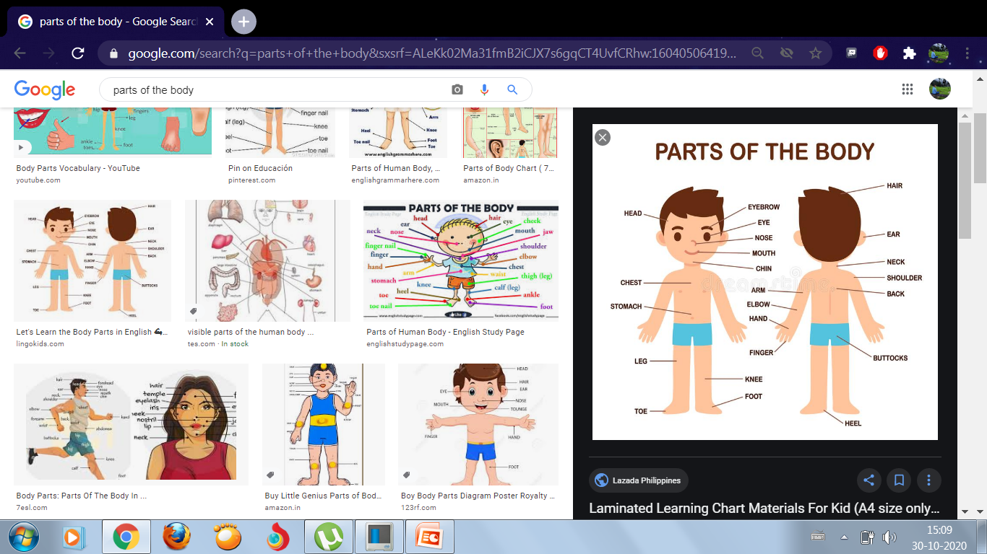
PARTS OF THE BODY

Slide 3
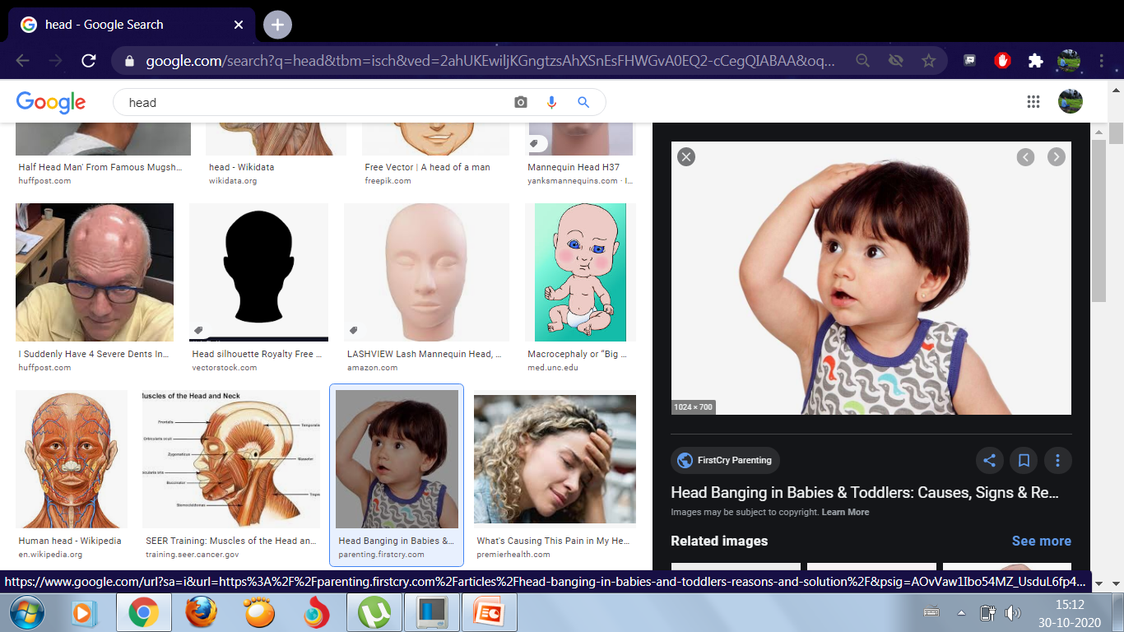
HEAD
The head is the main and topmost part of the body. Head consists of hair and face.

Slide 4
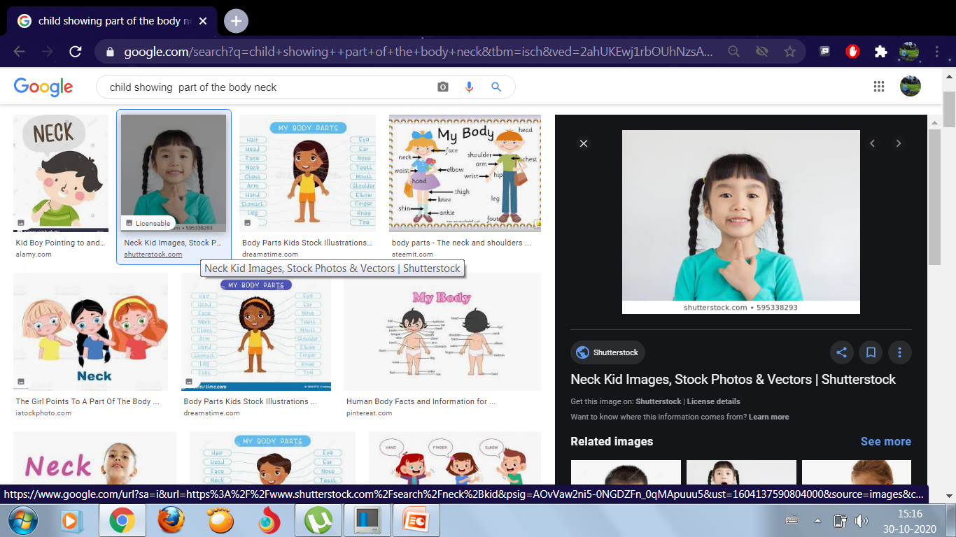
NECK
We can move our head with the help of our neck.

Slide 5
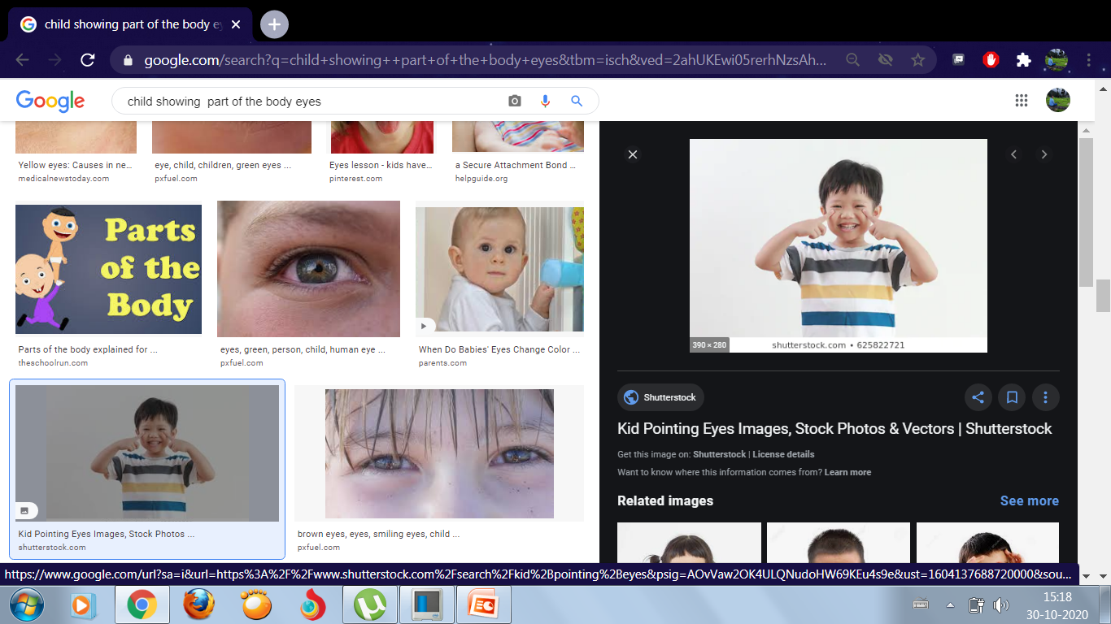
EYES
We have two eyes. We can see with the help of our eyes.

Slide 6
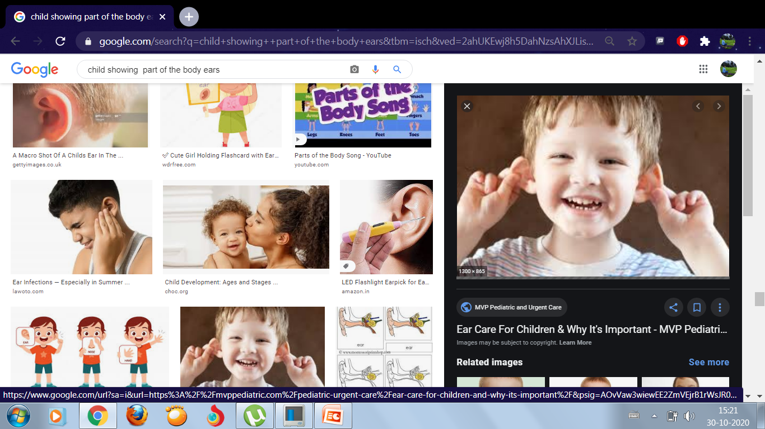
EARS
We have two ears. We can hear with the help of our ears.

Slide 7
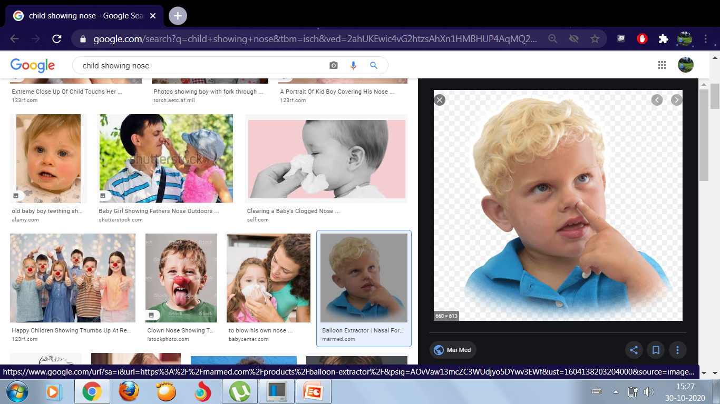
NOSE
We can smell with the help of our nose.

Slide 8
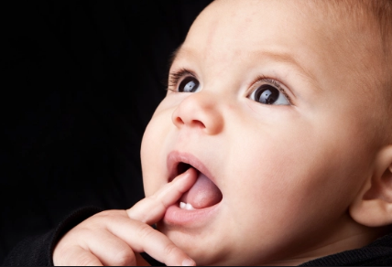
MOUTH
We can talk and eat with the help of our mouth.

Slide 9
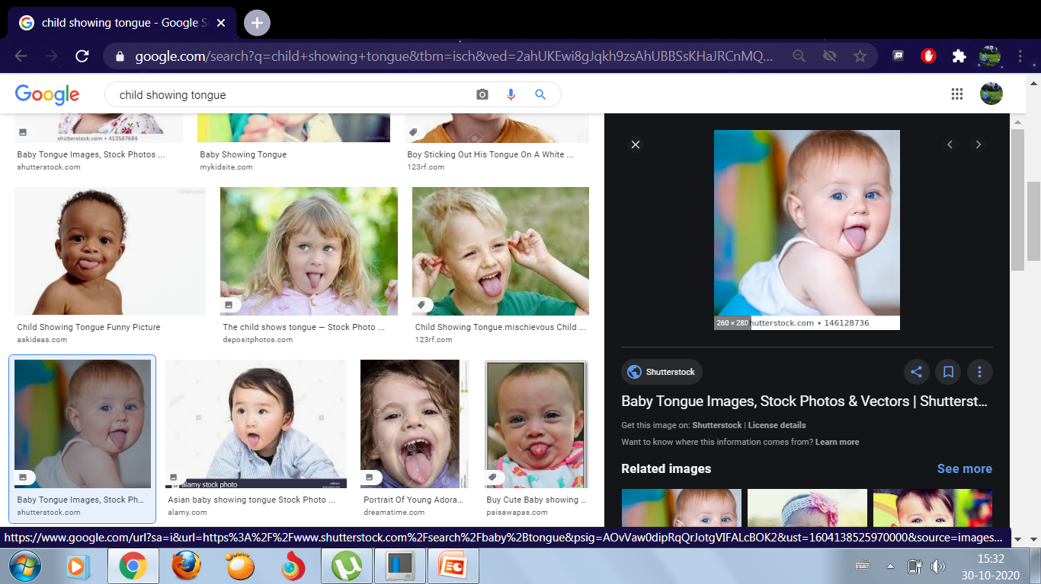
TONGUE
We can taste with the help of our tongue.

Slide 10
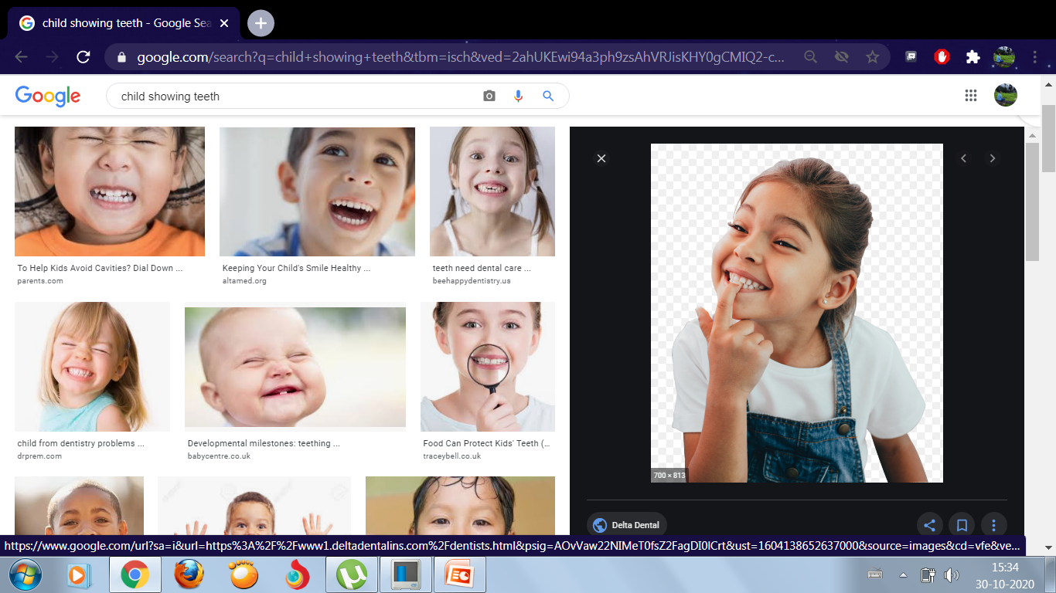
TEETH
We can chew our food with the help of our teeth.

Slide 11
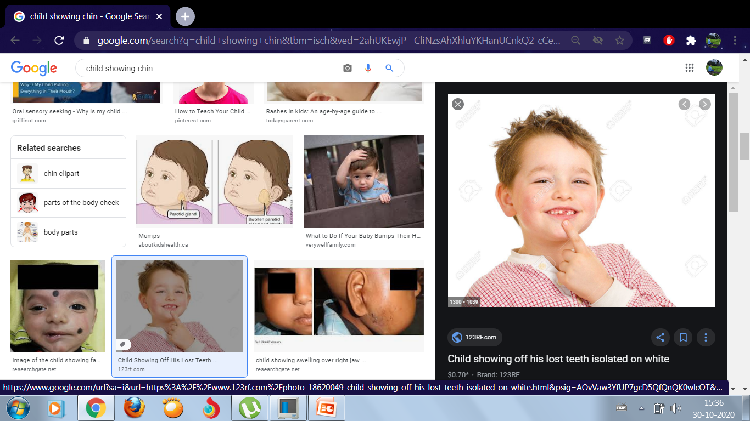
CHIN
Chin gives a nice shape to our face.

Slide 12
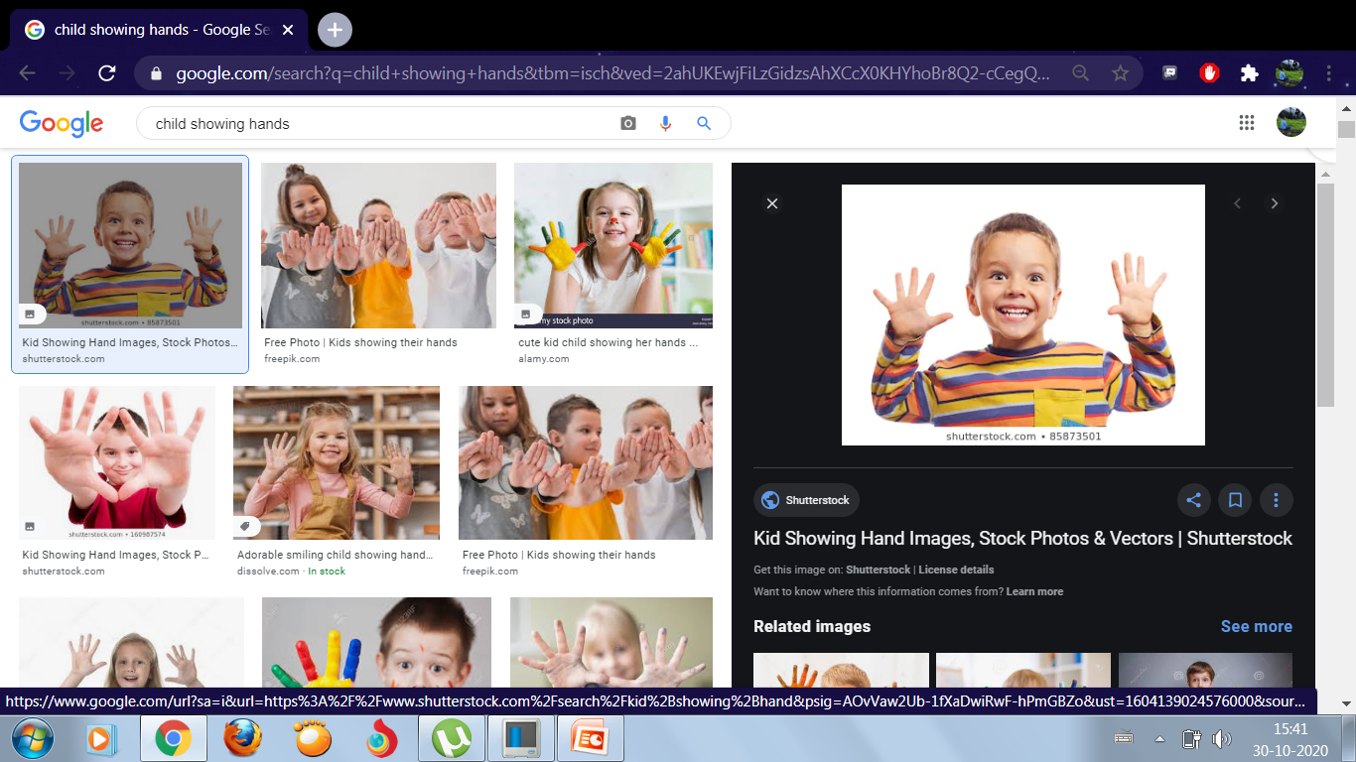
HANDS
We have two hands. Hands help us to do different kinds of works. Example- eat, write, carry things, etc.

Slide 13
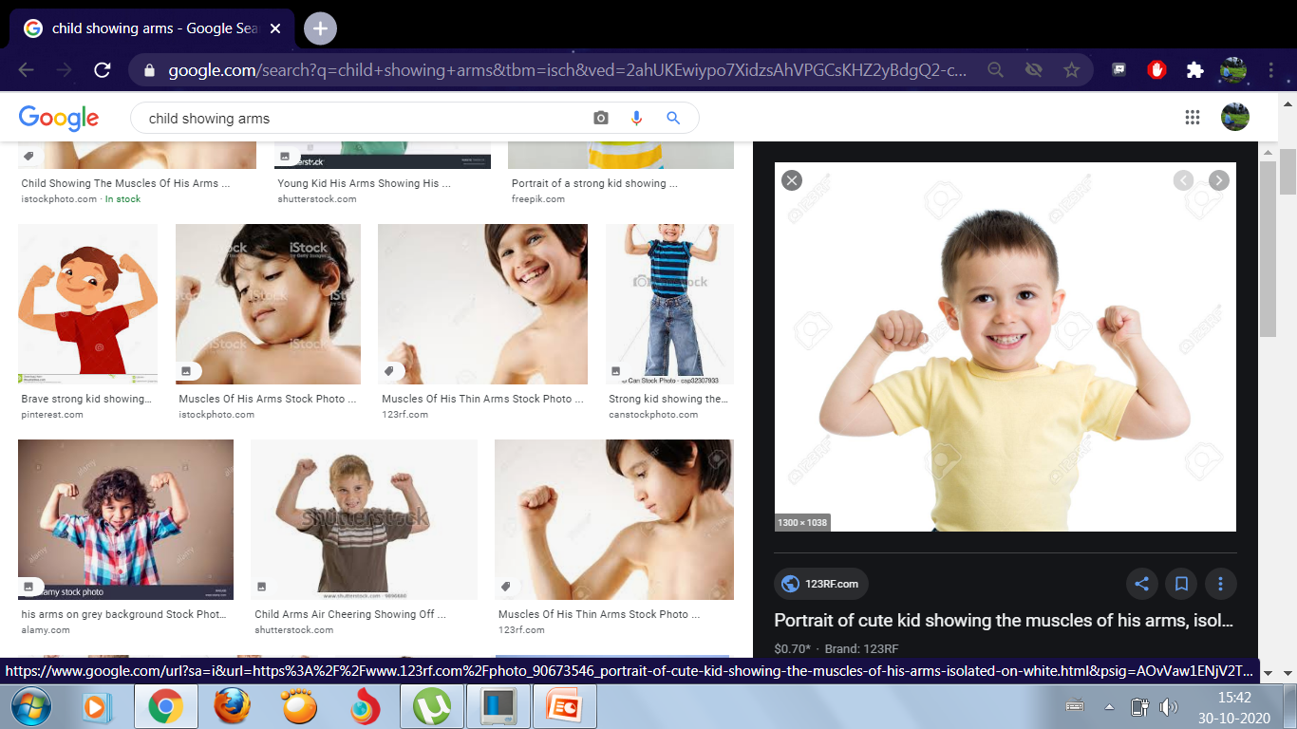
ARMS
We can wave with the help of our arms.

Slide 14
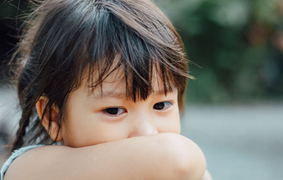
ELBOWS
Elbows, arms, hands, fingers, are all joined which helps us perform different tasks.

Slide 15
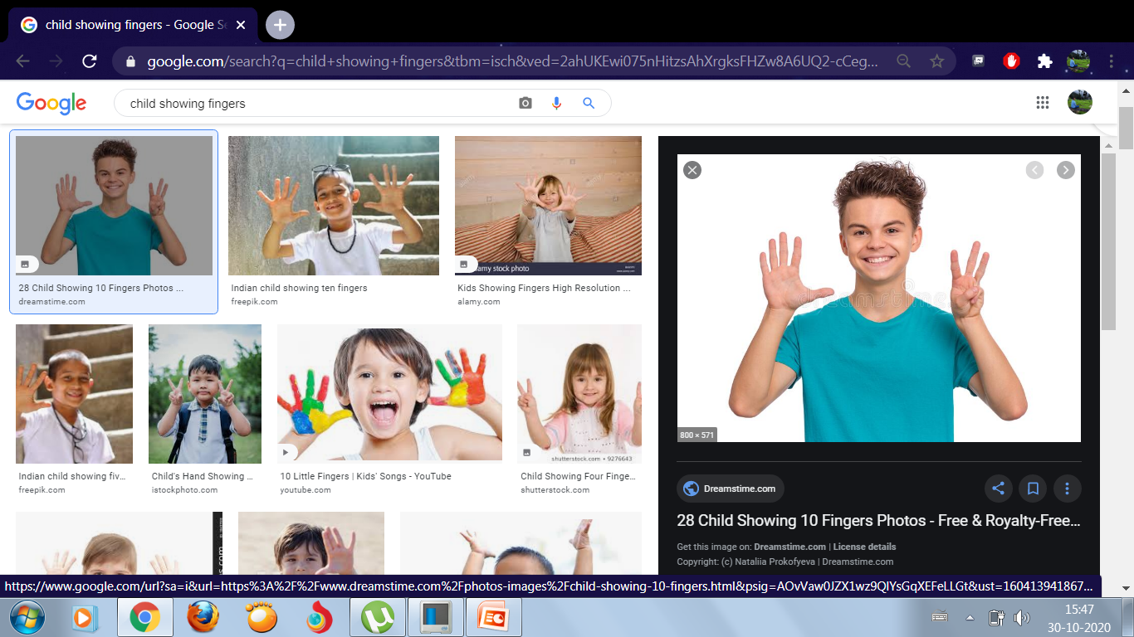
FINGERS
We have 10 fingers which helps us to hold things, write and eat.

Slide 16
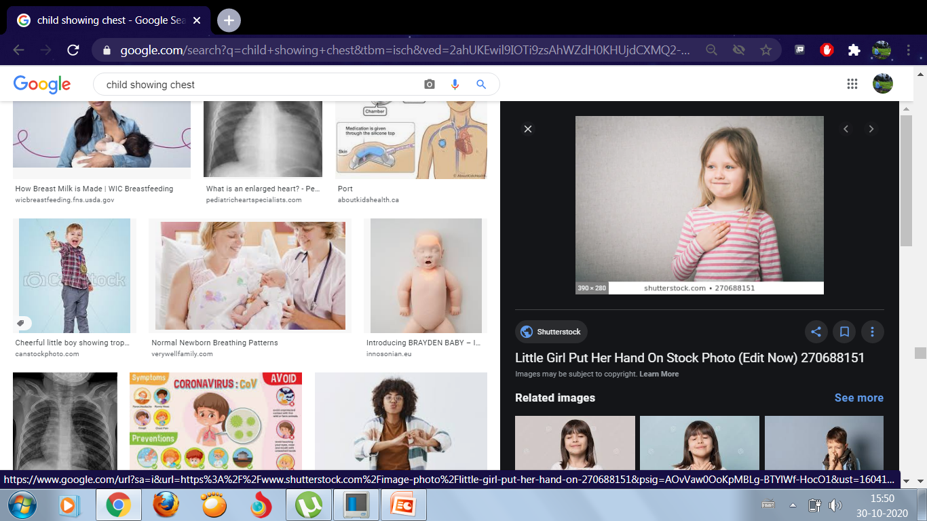
CHEST
We breathe in air through the nose, the air goes into the chest. We breathe out the air from the chest through our nose. This is a continues process.

Slide 17
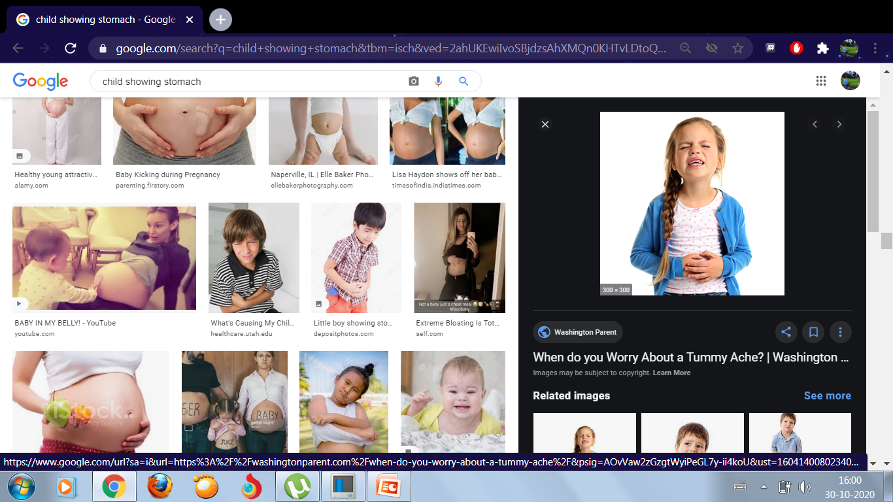
STOMACH
The food that we take in through our mouth enters to the stomach.

Slide 18
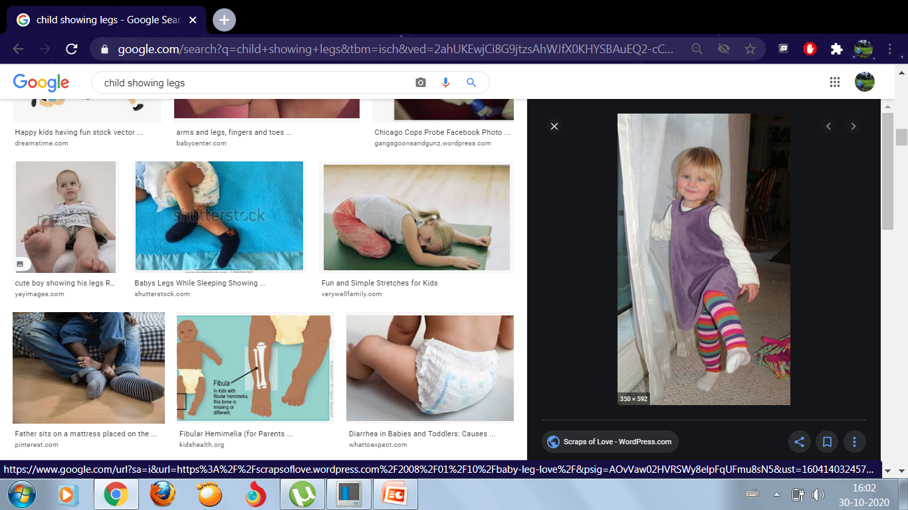
LEGS
We have two legs. We can walk with the help our legs.

Slide 19
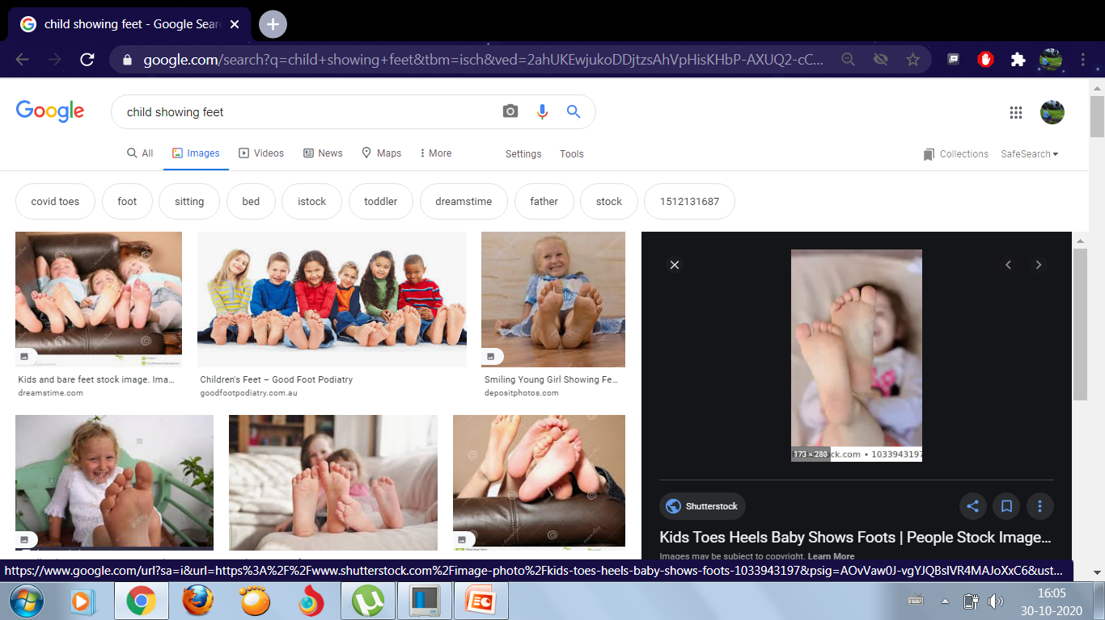
FEET
Feet helps us to run, jump, skip, etc.

Slide 20
WORK TO DO
Q1. See the pictures and write down the parts of the body.
Q2. Fill in the missing letters.
Q3.In your science exercise book write down the parts of the body.

Slide 21


