Slide 1

SUBJECT-SCIENCE
TOPIC-ANIMALS-BABIES

Slide 2
INTRODUCTION
Animals are the beautiful creation in this world. There are lots of different kinds of animals living on earth. That means there are lots of different kinds of baby animals. Some of the animals lay eggs and some give birth to their young ones.

Slide 3
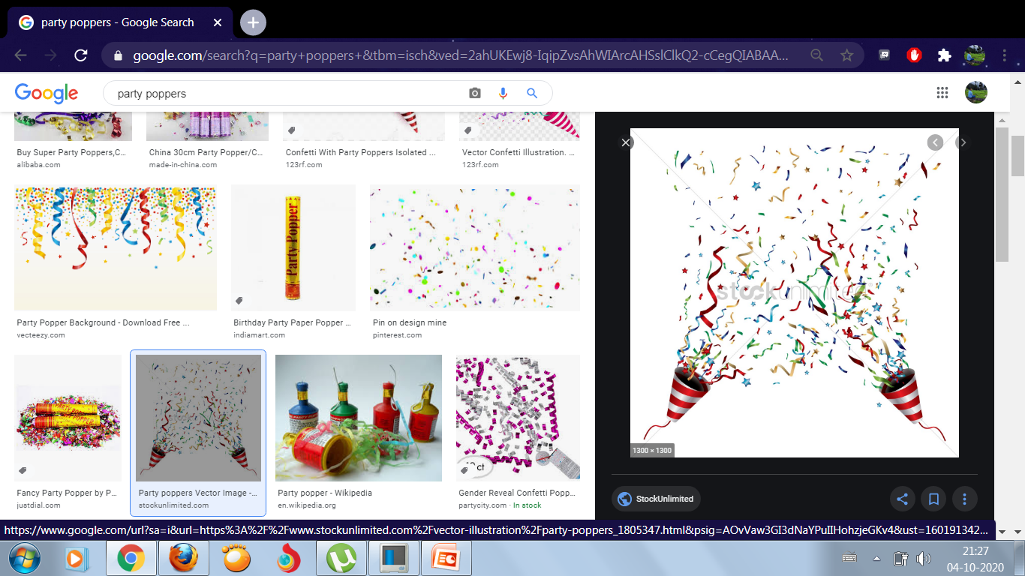
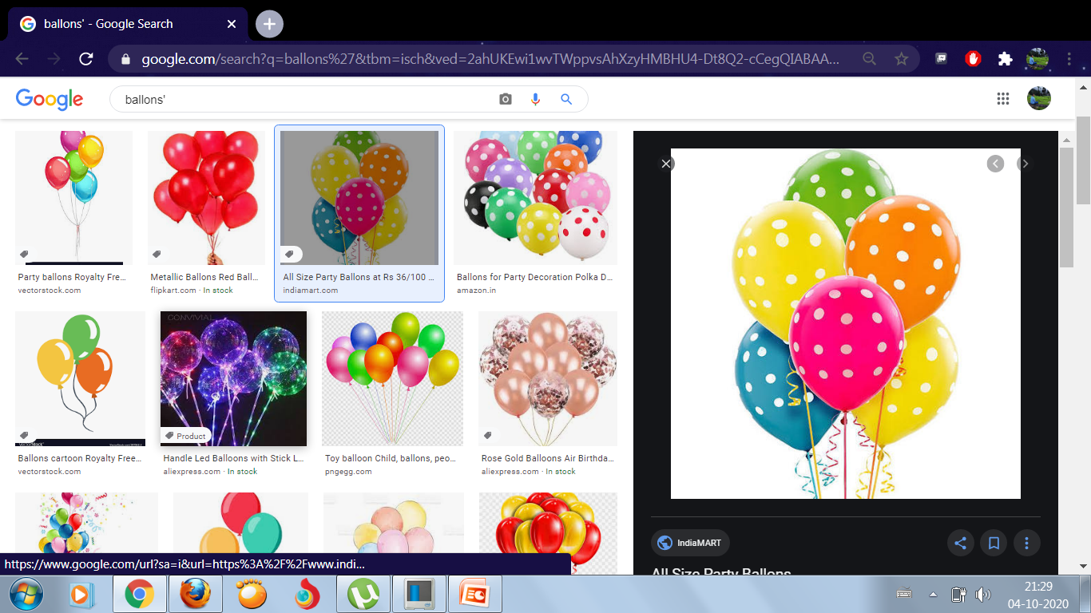
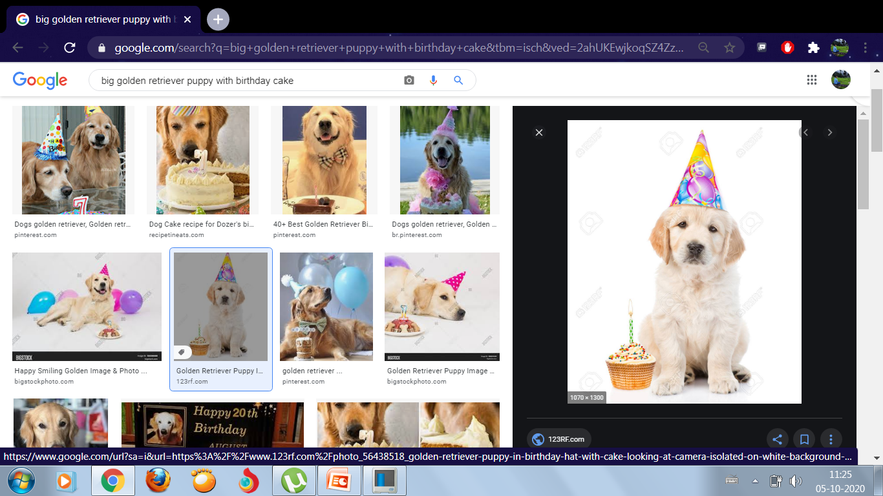
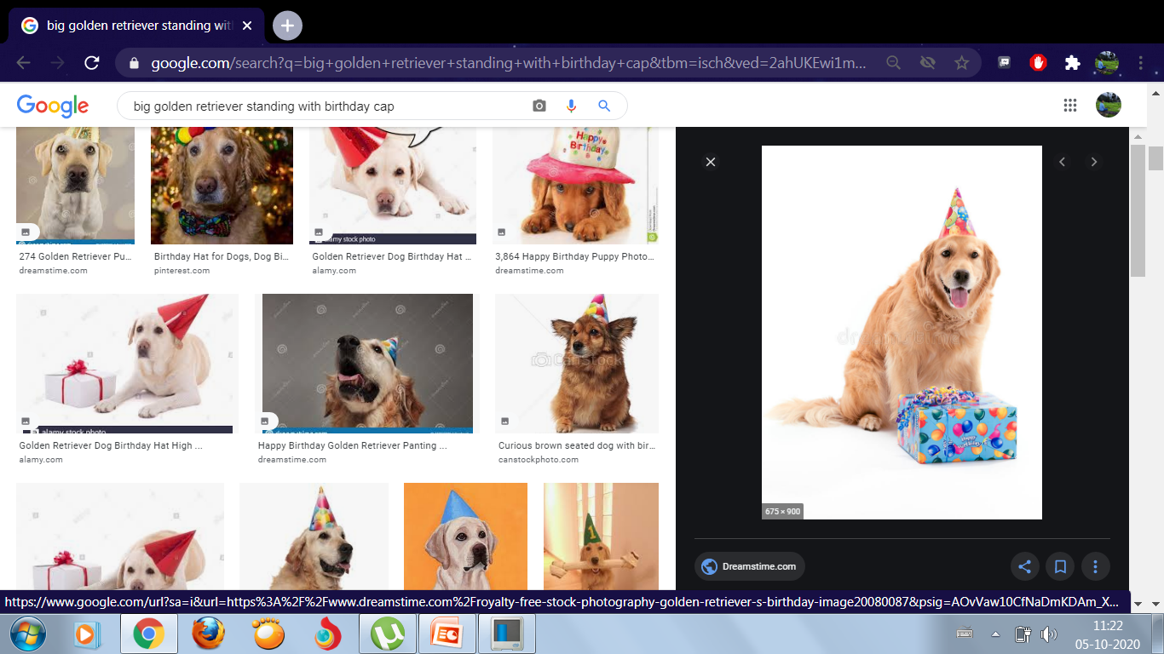
Happy Birthday
Puppy
Daddy dog is celebrating baby puppy’s birthday.

Slide 4
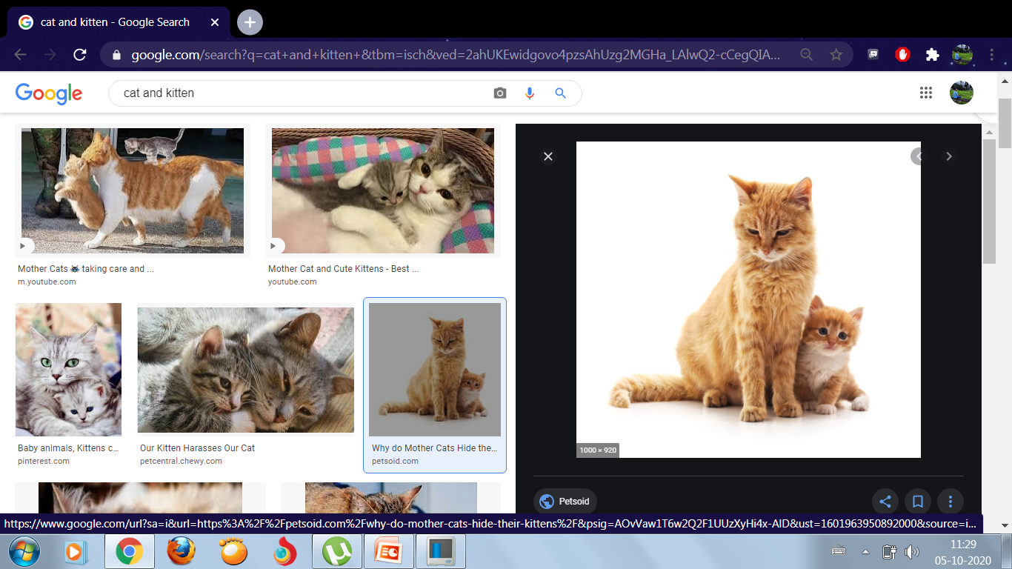
Cat is come with baby kitten.

Slide 5
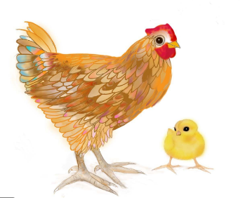
Hen is come with baby chick.

Slide 6
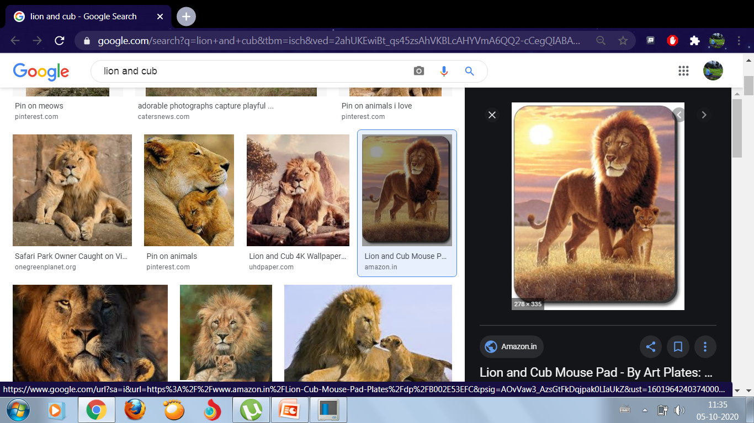
Lion is come with baby cub.

Slide 7
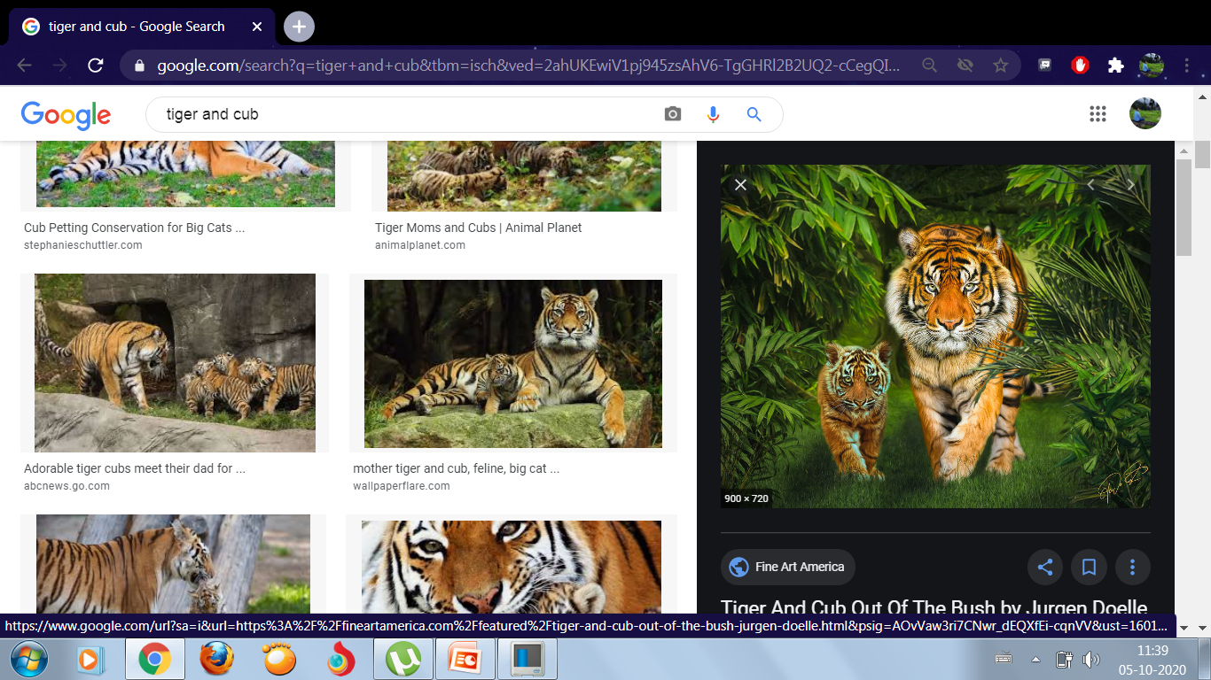
Tiger is come with baby cub.

Slide 8
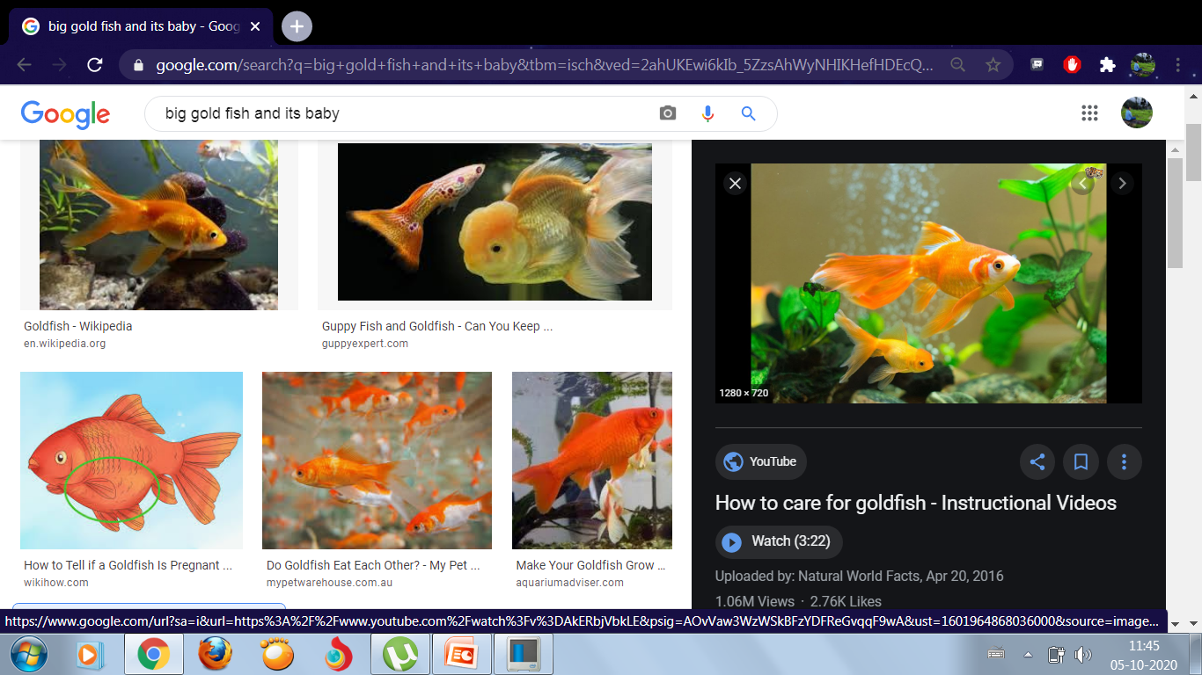
Fish is come with baby fry.

Slide 9
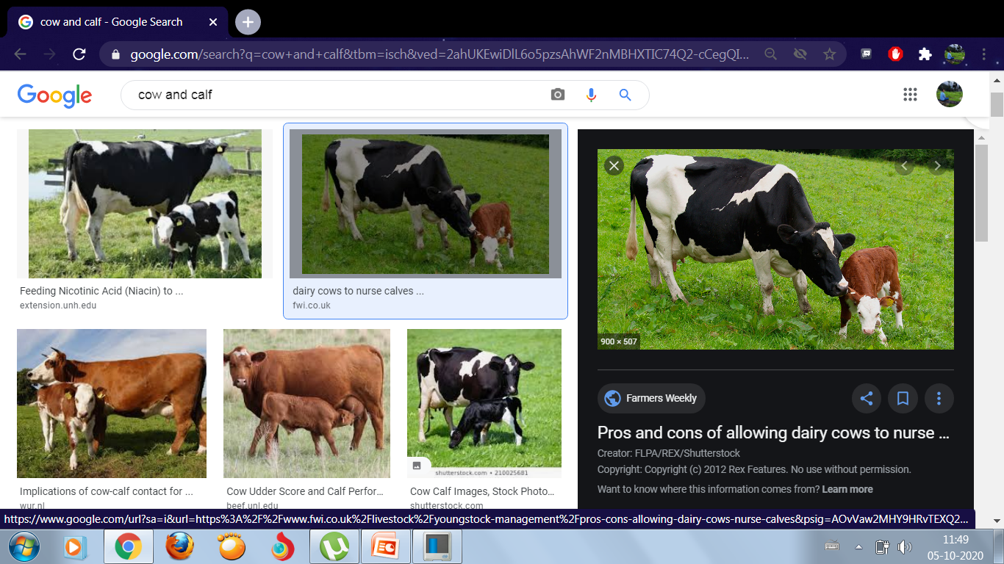
Cow is come with baby calf.

Slide 10
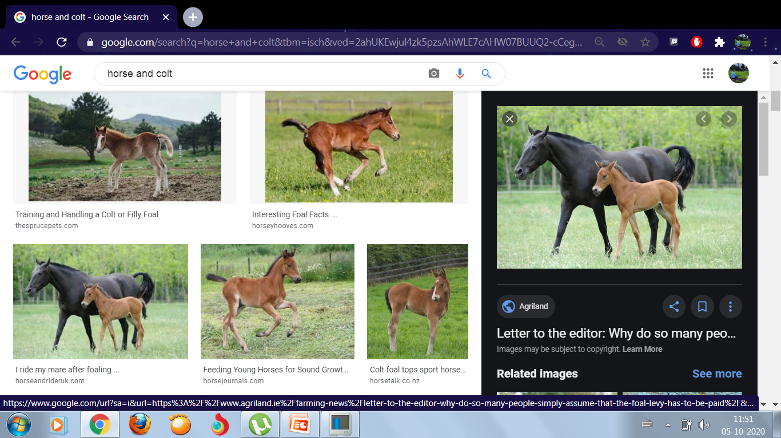
Horse is come with baby colt.

Slide 11
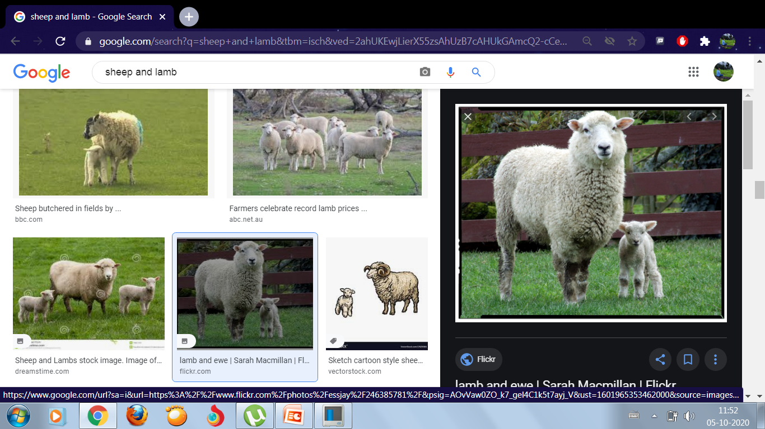
Sheep is come with baby lamb.

Slide 12
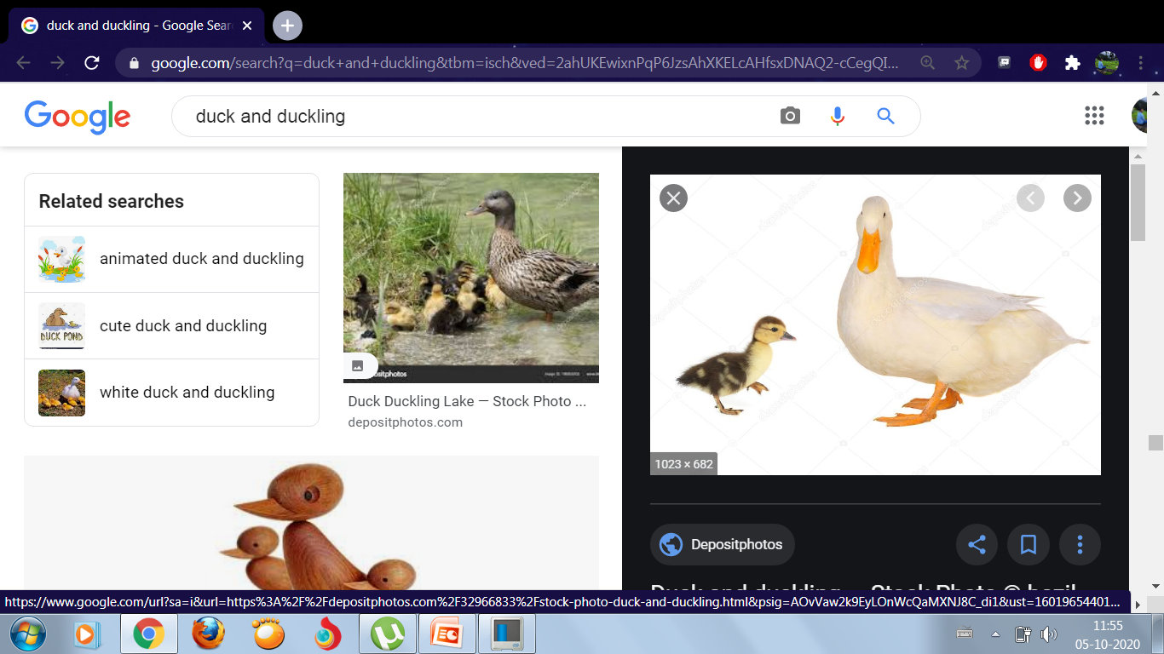
Duck is come with baby duckling.

Slide 13
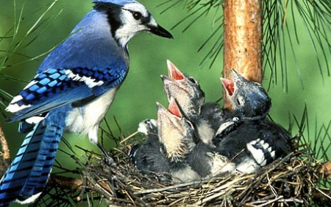
Bird is come with baby nestling.

Slide 14
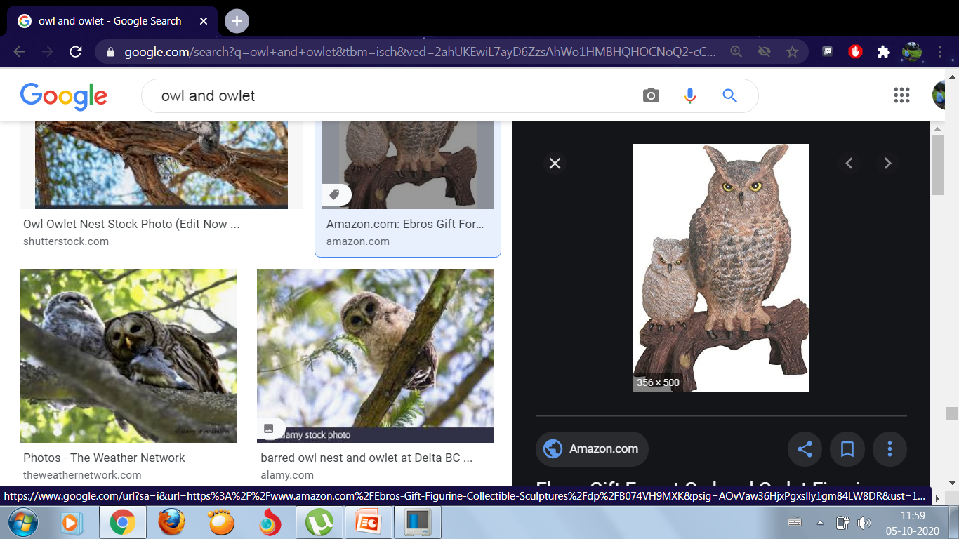
Owl is come with baby owlet.

Slide 15
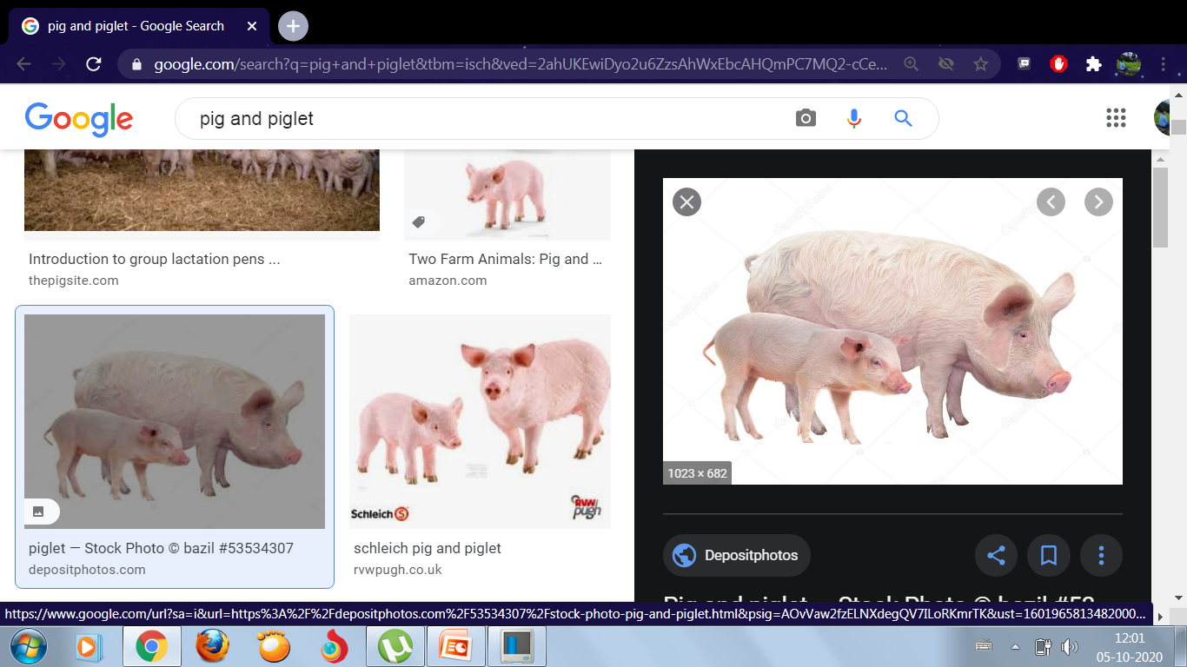
Pig is come with baby piglet.

Slide 16
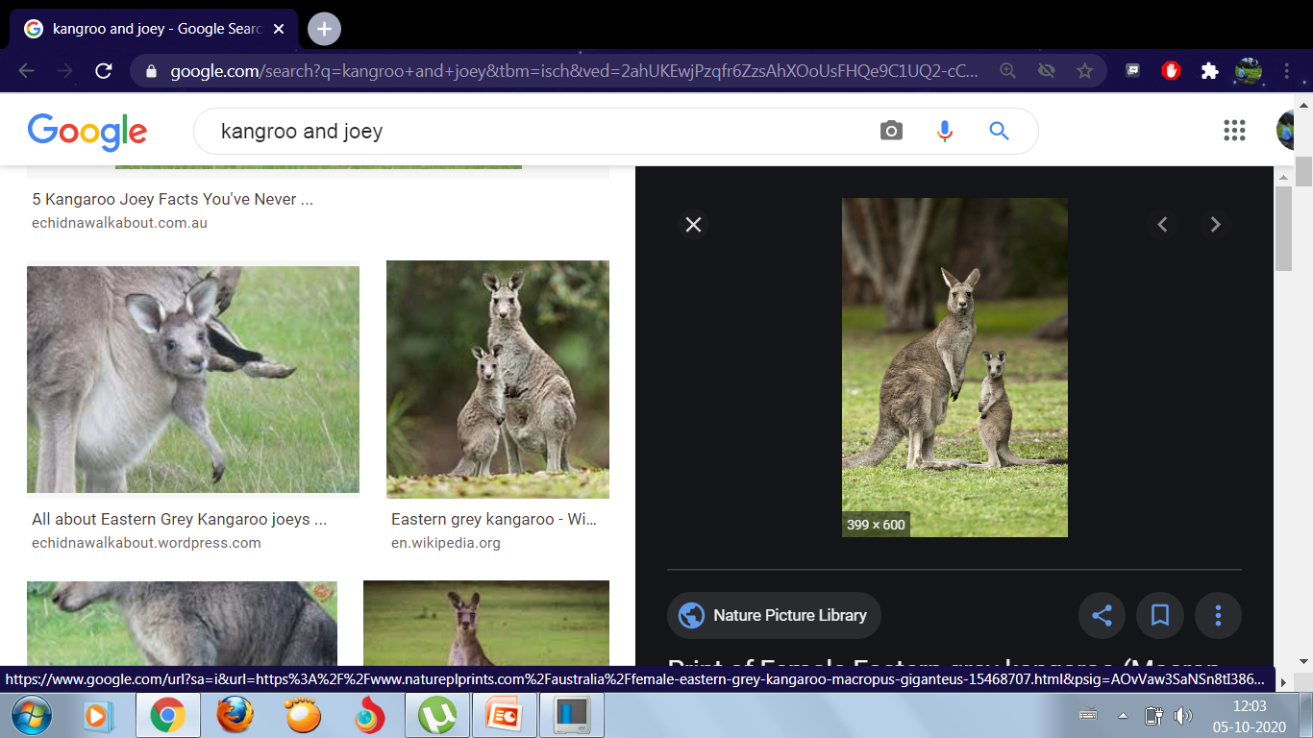
Kangaroo is come with baby joey.

Slide 17
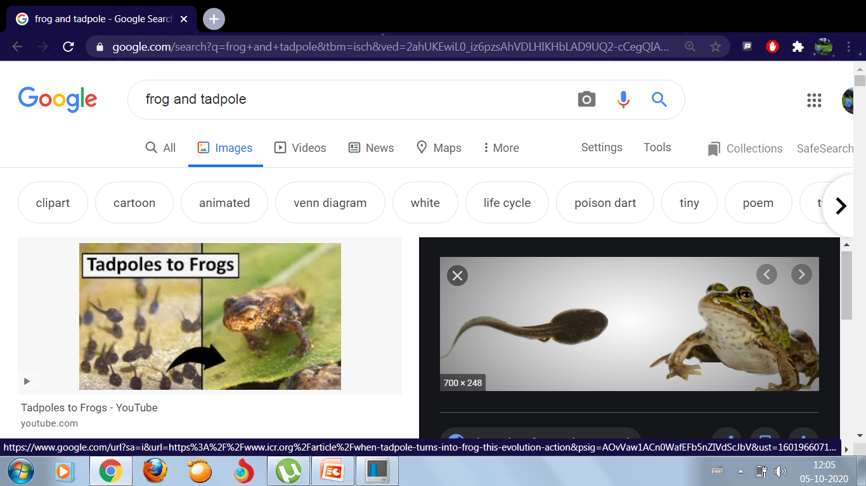
Frog is come with baby tadpole.

Slide 18
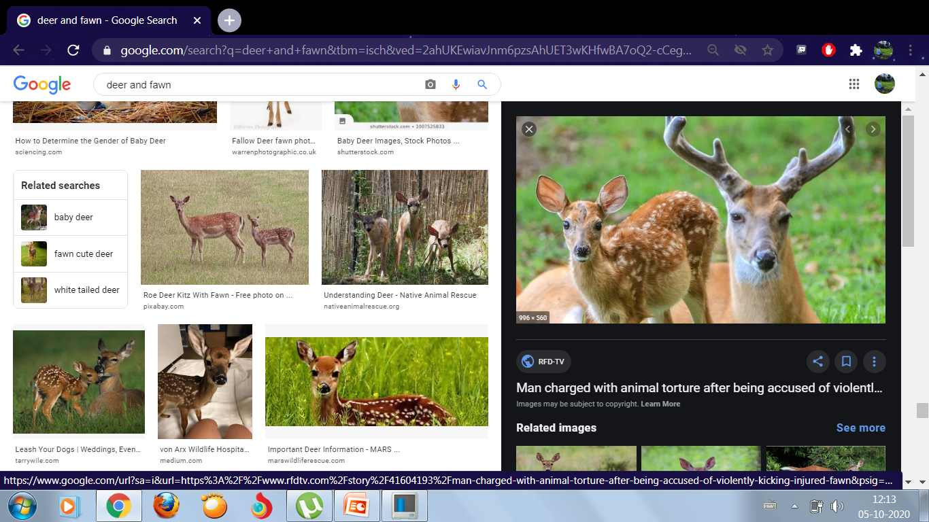
Deer is come with baby fawn.

Slide 19
WORK TO DO
Q1) See the pictures and write down the name of the animal babies.
Q2) Write down the name of the animal babies.
Q3) Match the following.
REVISION WORK-
Q1) Fill in the blanks.
Q2) Fill in the missing letters.
Q3) Match the following.
Q4) Name them.

Slide 20


