Slide 1

SUBJECT-SCIENCE
TOPIC-FLOWERS

Slide 2
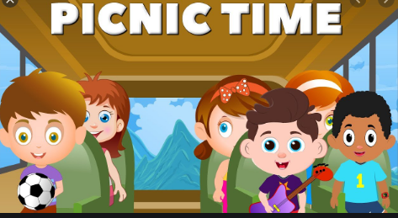
TIME FOR A CLASS PICNIC

Slide 3
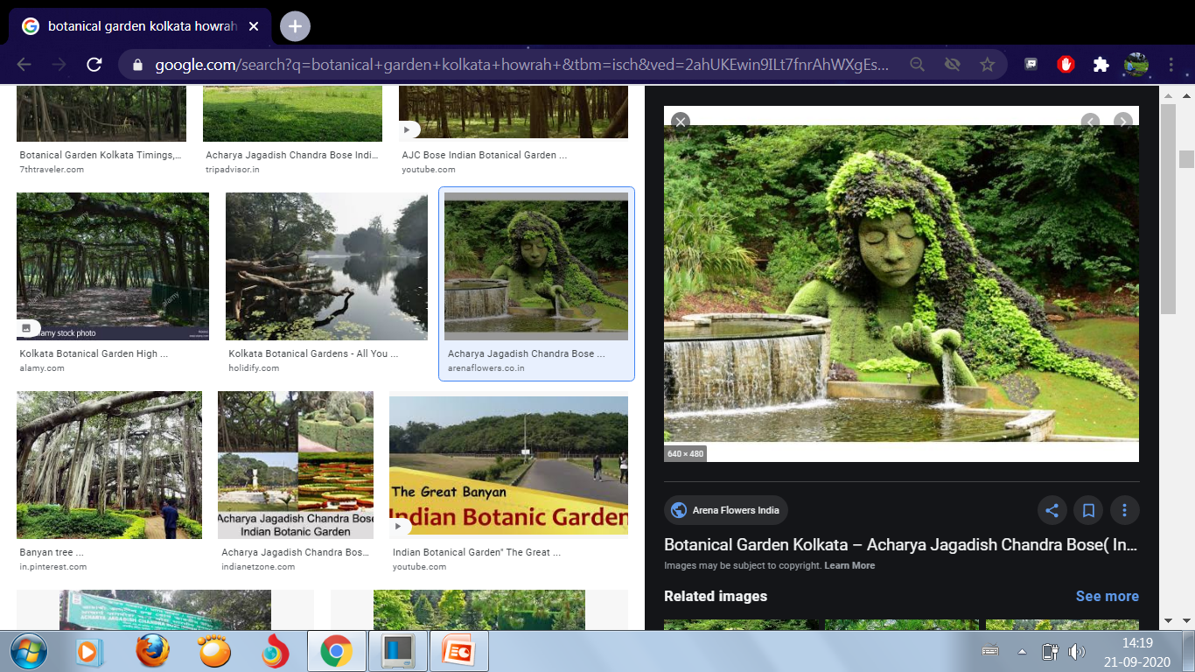
Visit to Botanical garden.

Slide 4
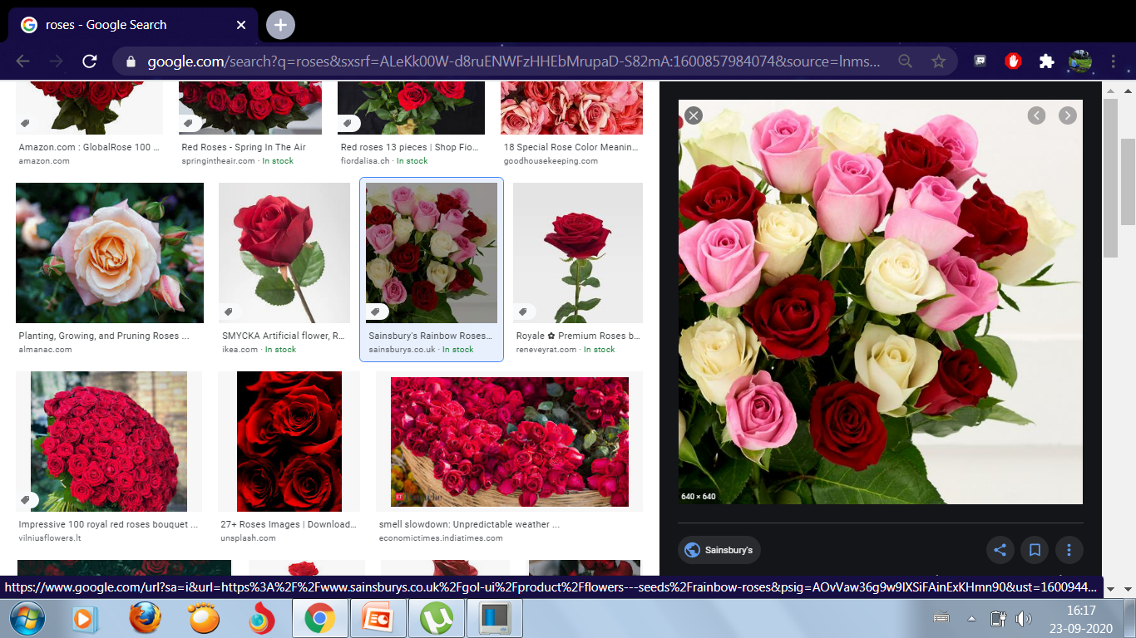
Rose
Rose is a beautiful flower. There are different types of rose plants. Roses grow in gardens, we see red, yellow and pink roses.

Slide 5
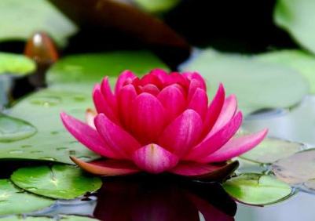
Lotus
Lotus is the National flower of India. It has round leaves floating in water. Lotus flowers grow in ponds and lakes.

Slide 6
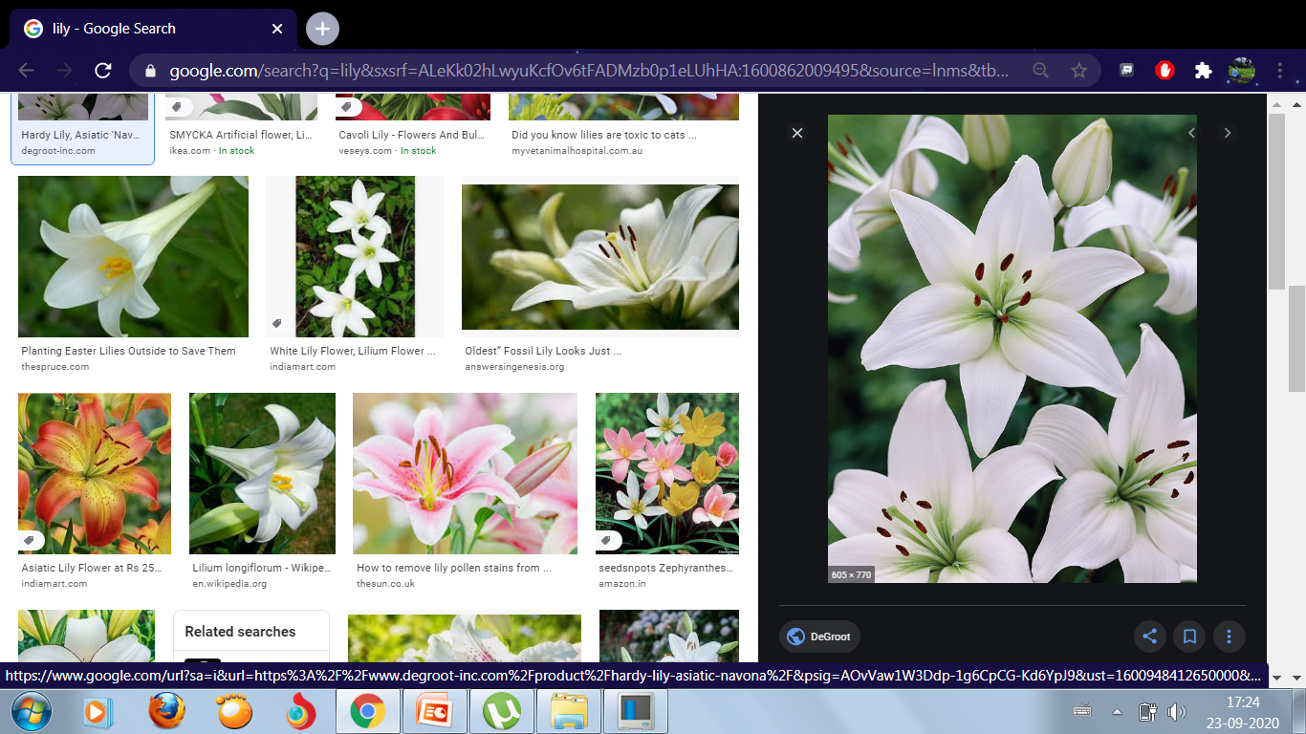
Lily
There are many types of lilies like trumpet lily, tiger lily, peace lily, etc . They have long leaves.

Slide 7
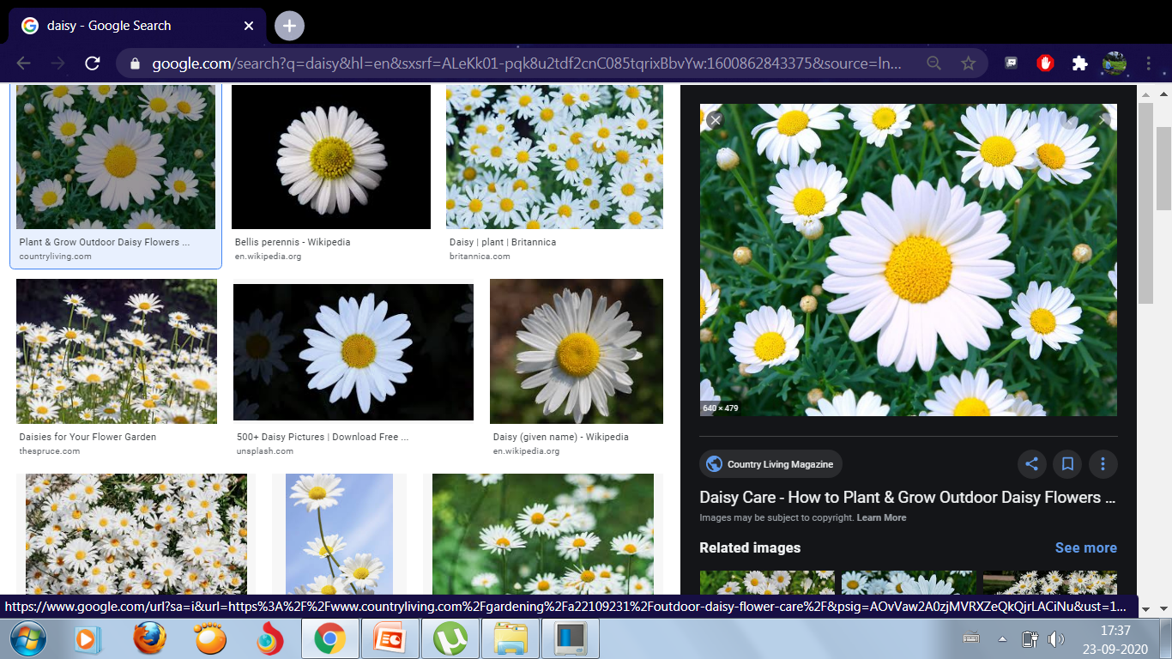
Daisy
Daisies are flowers with flat petals that surround a round centre.

Slide 8
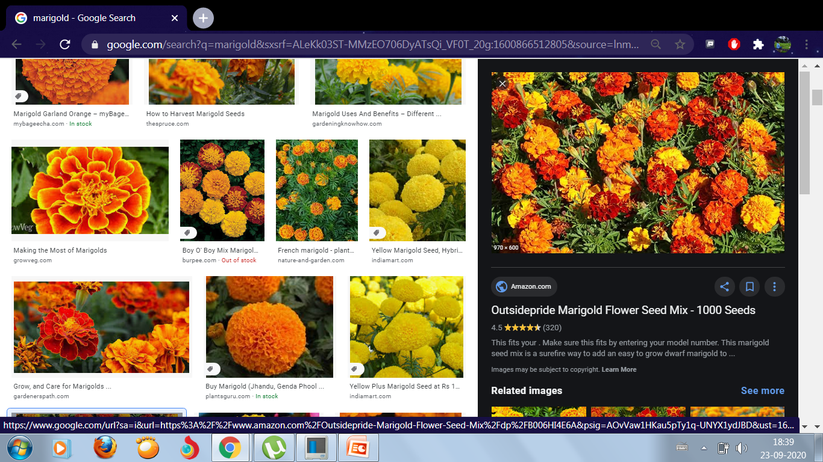
Marigold
Marigold are usually yellow, orange and red in colour. They look like beautiful orange and yellow balls. They have many small petals together.

Slide 9
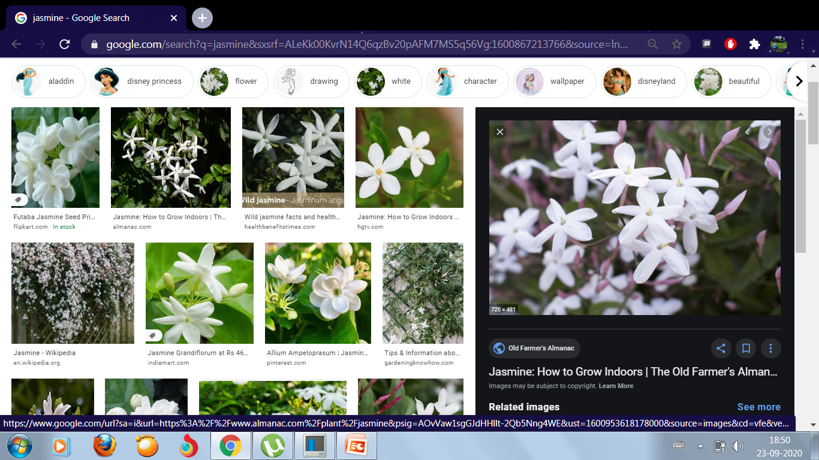
Jasmine
They are white in colour and have a strong and sweet smell.

Slide 10
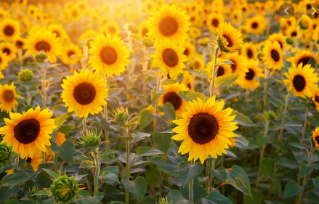
Sunflower
They are called sunflower because they follow the movement of the sun. They have bright yellow petals and a brown-black centre which makes it look bright and colourful.

Slide 11
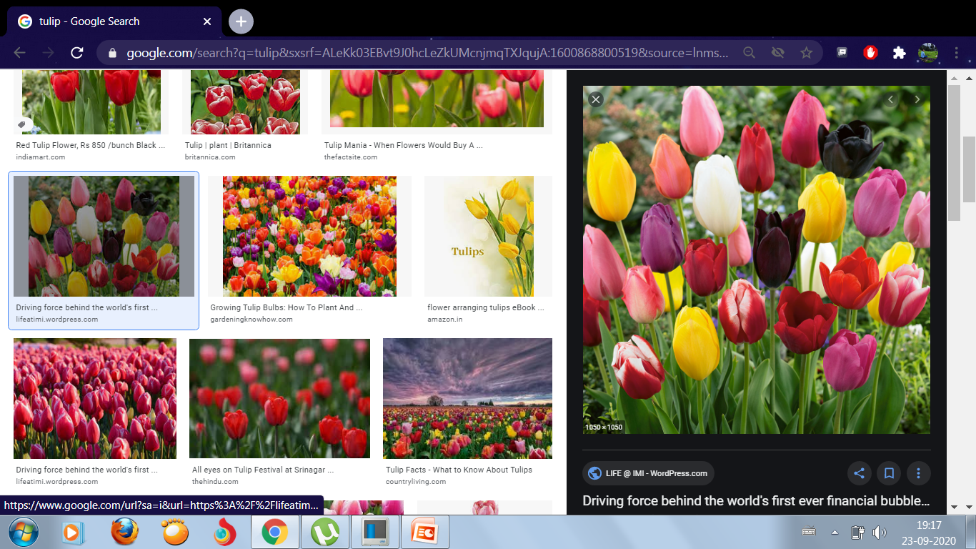
Tulip
Tulip flowers are cup shaped. They grow during early spring season. There are different colour tulips like pink, yellow, red, etc.

Slide 12
WORK TO DO
Q1. See the pictures and write down the name of flowers.
Q2. Fill in the missing letters.
Q3.In your science exercise book write down the name of 8 flowers and stick pictures.

Slide 13
