Slide 1
SUBJECT – SCIENCE TOPIC - BIRDS

Slide 2
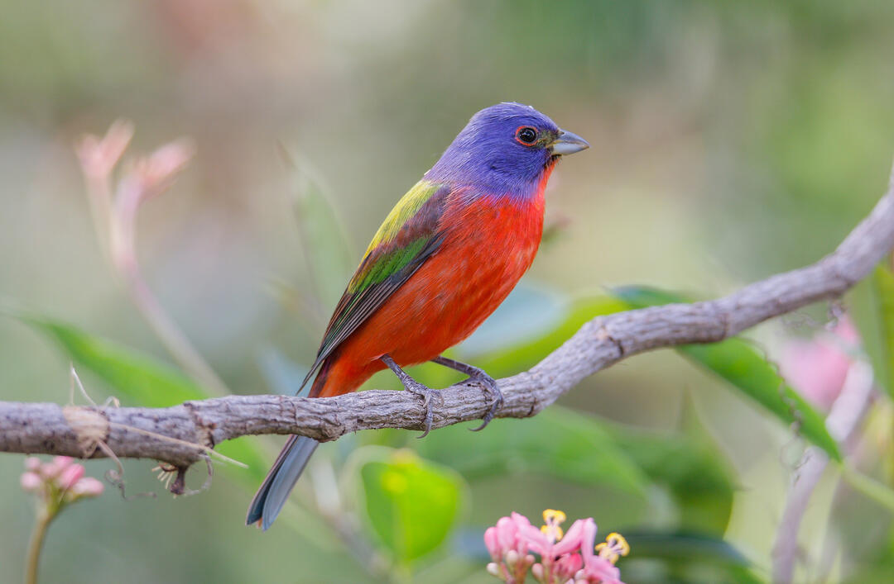
HAVE YOU SEEN A BIRD?

Slide 3
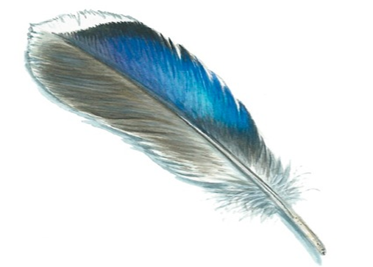
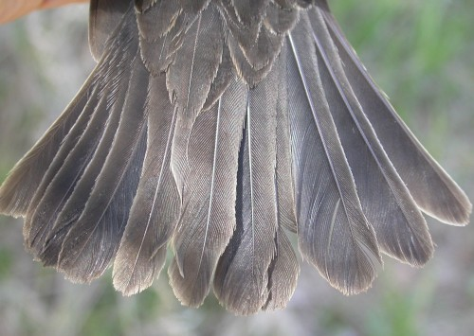
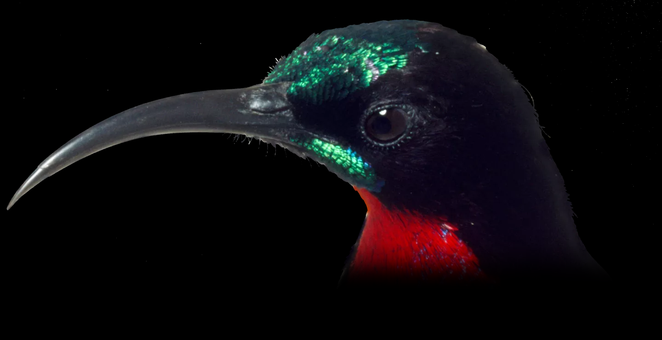
CHARACTERISTICS OF A BIRD
FEATHER TAIL BEAK

Slide 4
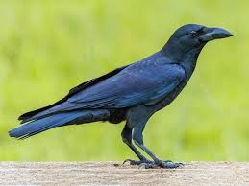
CROW
This is a crow .It is black in colour. It has a sharp beak to eat its food. The crow is regarded as a clever bird. They eat both plants and flesh of animals.

Slide 5
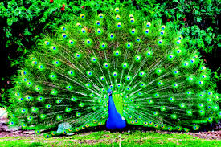
PEACOCK
This is a peacock. It has a huge fan like colourful feathers. It has a long neck. The peacock is the national bird of India. You know, the peacock loves to dance in the rain. They eat seeds of plants and small insects.

Slide 6
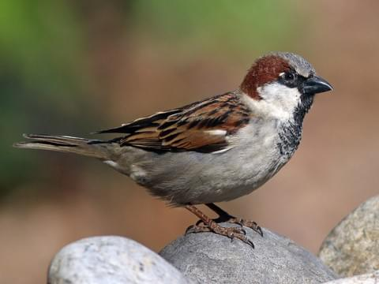
SPARROW
This is a sparrow. Sparrows are of small size. It is brown in colour. They are very active in nature and sparrows love to eat seeds with their tiny beak.

Slide 7
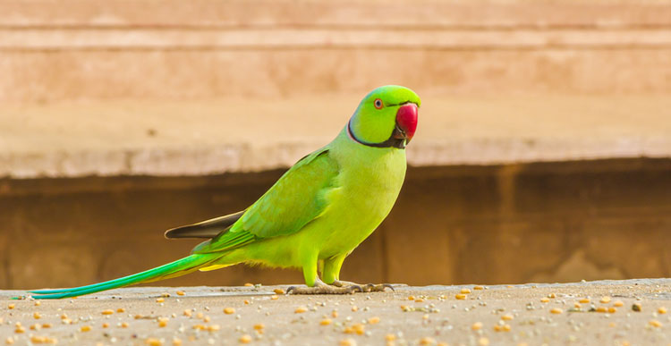
PARROT
This is a parrot. Parrots are pet animals. It has a curved beak and sharp clawed feet. The parrot is green in colour and one of the most beautiful birds in the world. Parrots love to eat seeds of the plants, fruits and chillies.

Slide 8
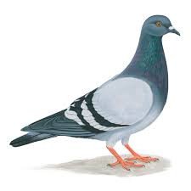
PIGEON
This is a pigeon. It has small feet and a beak. They love to eat seeds.

Slide 9
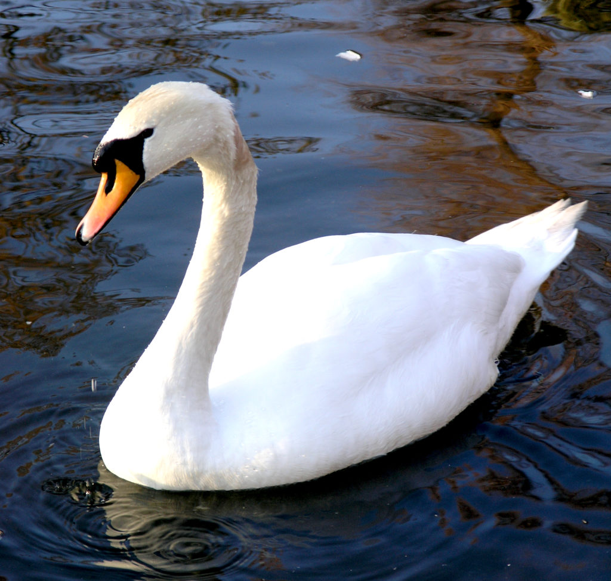
SWAN
This is a swan. Swans are water birds with heavy bodies and long necks. They are white in colour. They are also strong fliers and eat grass, worms, small fish and frogs.

Slide 10
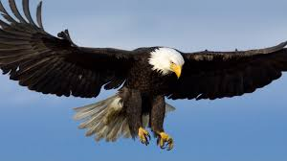
EAGLES
Eagles are large, powerful birds of prey. Eagles have large hooked beaks and powerful talons which help them catch prey. Eagles build their nest on high cliffs or tall trees. They eat other animals and birds.

Slide 11
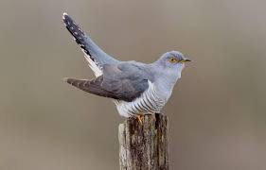
CUCKOO
This is a cuckoo. Cuckoos have a long tail and a medium to long legs. Its outer toe is pointed backward. There are different colour cuckoos like blue, brown, grey and they have different combinations of spots and patterns. They eat insects.

Slide 12
WORK TO DO
Q 1. See the pictures and write down the name of the birds.
Q 2. Fill in the missing letters.
Q 3. In your science exercise book write down the name of 8 birds and stick pictures.

